Slide 1

Problem Formulation
Course 3, Module 4, Lesson 1

Slide 2
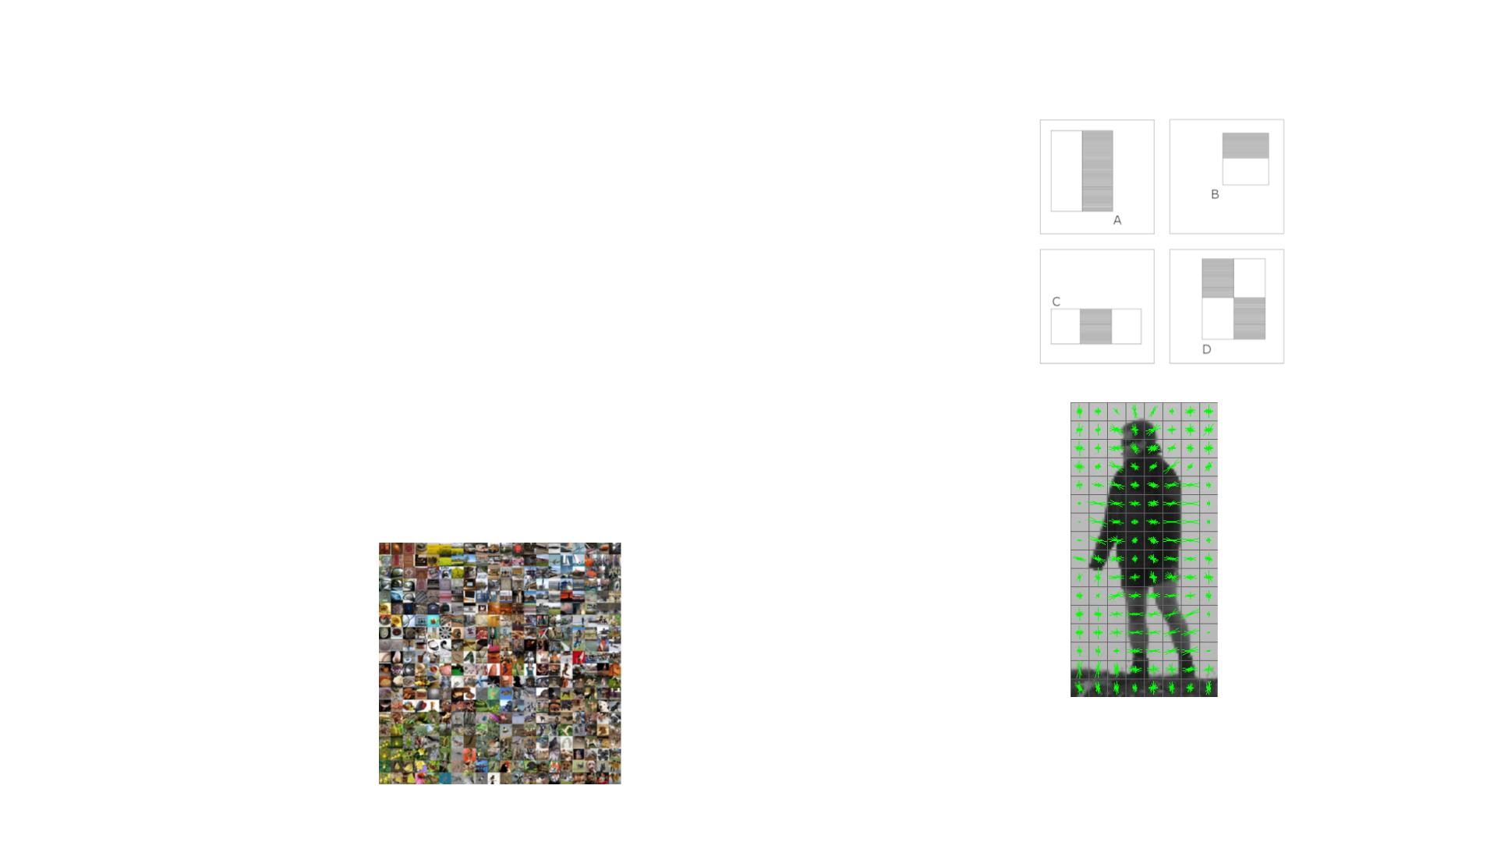
Brief History of Object Detection
• 2001 – Viola, Jones – Viola Jones Object Detection
Framework
face detection.
• 2005 – Dalal, Triggs – Histogram of Oriented
Gradients
pedestrian detection.
SIFTはHOGを使っている
• 2012 – Krizhevsky, Sutskever, Hinton - Alexnet
in 2012, it was the only deep learning-based entry in the challenge.
Imagene

Slide 3
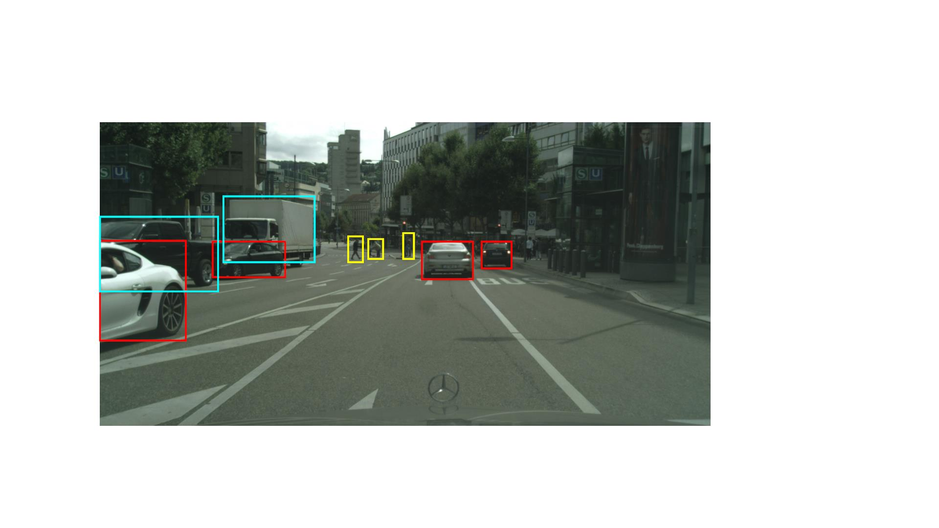
The Object Detection Problem
Given a 2D image input, to estimate the location defined by a bounding box and the class of all objects in the scene.
For self-driving cars, we usually are most interested in object classes that are dynamic.
These include vehicles and their subclasses, pedestrians, and cyclists.
Car
Truck
Pedestrian

Slide 4
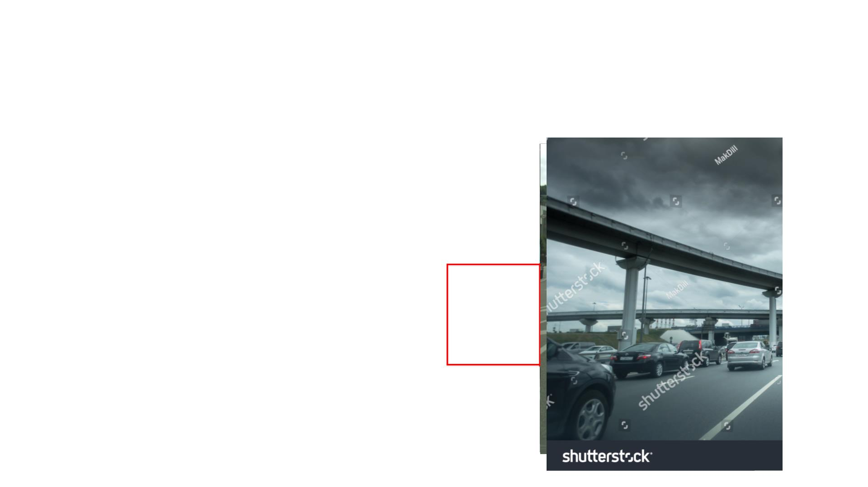
This requires the algorithm to be able to hallucinate（幻覚を起こす） the extent of objects to properly detect them.
Object Detection Is Not Trivial !
extent: The extent of something is its length, area, or size.（辞書）
This phenomenon creates huge variability in the bounding box sizes.
• Extent of objects is not fully observed!
o Occlusion: Background objects covered by
foreground objects
o Truncation（切り捨て）: Objects are out of image boundaries
• Scale: Object size gets smaller as the object
moves farther away
The algorithm is expected to determine the class of these objects at variable scales.
• Illumination Changes:
o Too bright
o Too dark
whole image illumination variations from bright sun to night driving.
partial variations due to reflections, shadows, precipitation, and other nuisance（やっかいなもの） effects.

Slide 5
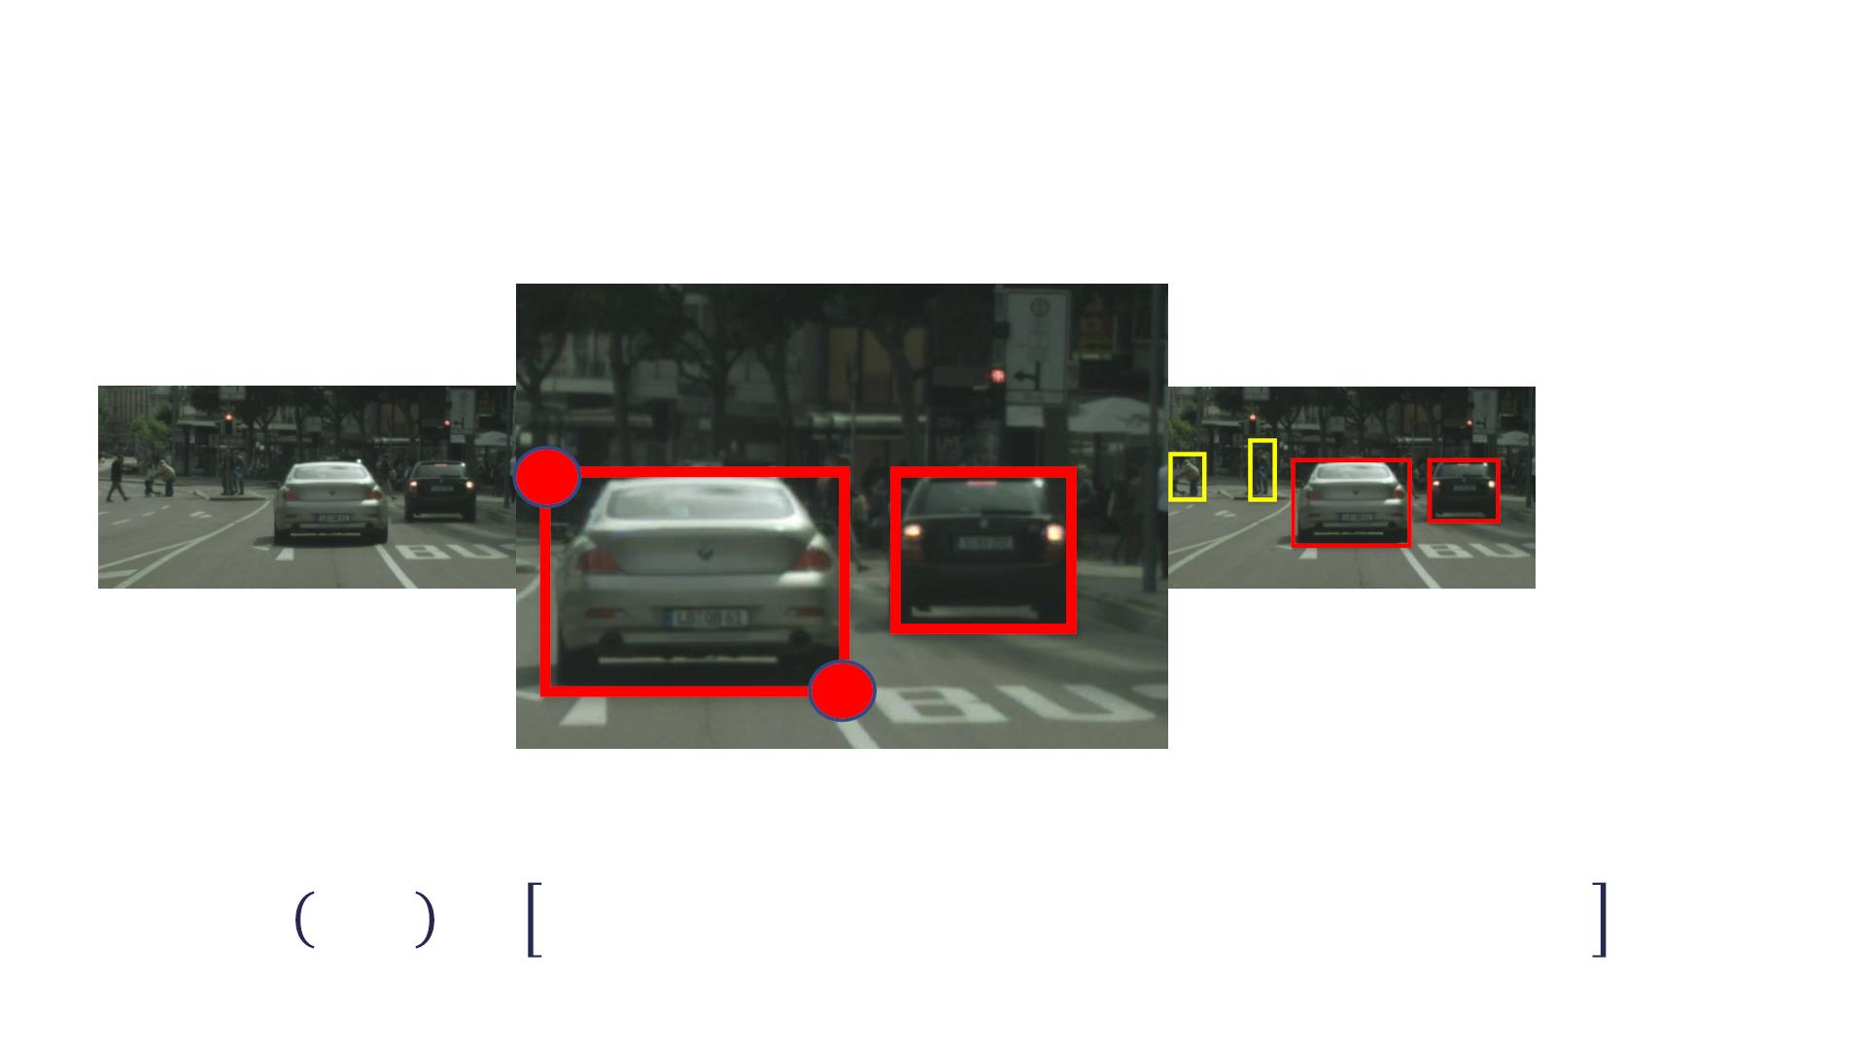
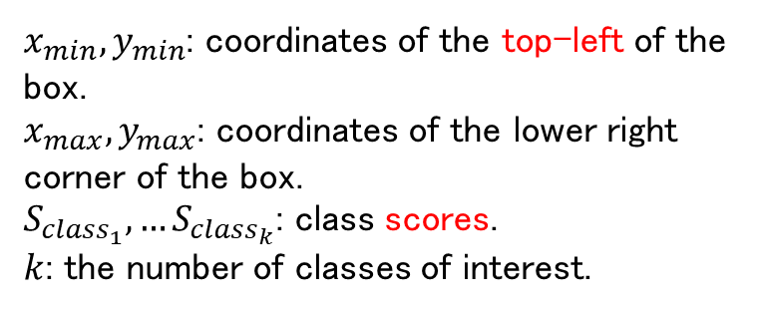
Mathematical Problem Formulation
$x_{min}, y_{min}$: coordinates of the top-left of the box.
$x_{max}, y_{max}$: coordinates of the lower right corner of the box.
$S_{class_{1}}, …S_{class_{k}}$: class scores.
$k$: the number of classes of interest.
! , %
!"# !"#
!"#$ = &. ((
!_{)*+} = &. &,
! , %
!$% !$%
& '; ( = ' , * , ' , * , + … , +
&'( &'( &)* &)* +,)--
+,)--
.
-

Slide 6
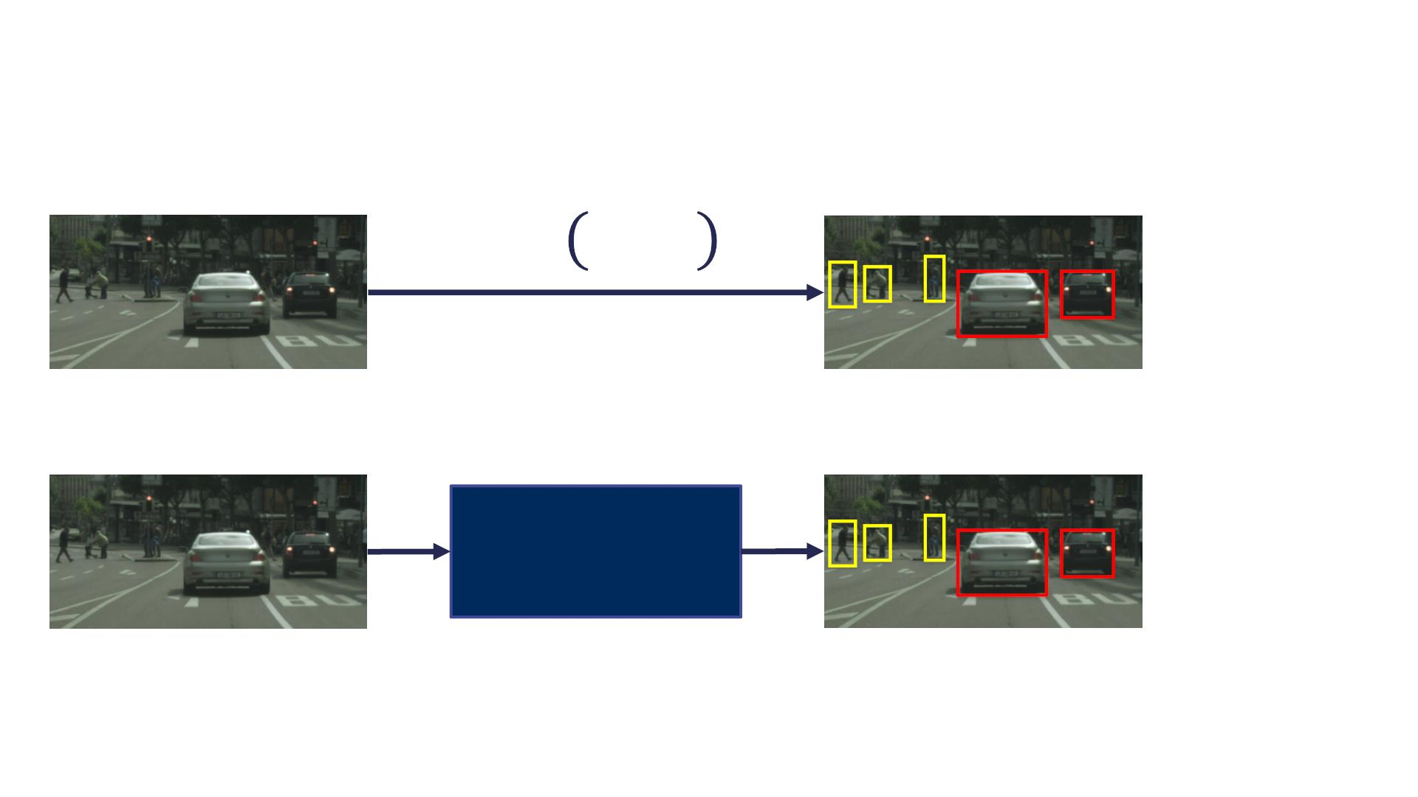
ConvNets For Object Detection
! "; $
ConvNet

Slide 7
交叉「こうさ」、
共通集合
合併「がっぺい」、和集合

Slide 8

Evaluation Metrics
• True Positive (TP): Object class score > score threshold, and
IOU > IOU threshold
• False Positive偽陽性 (FP): Object class score > score threshold, and
IOU < IOU threshold
• False Negative偽陰性 (FN): Number of ground truth objects not
detected by the algorithm
• Precision適合率: TP/ (TP + FP)
• Recall再現率: TP / (TP + FN)
divided by the total number of ground truth objects.
• Precision Recall Curve (PR-Curve): Use multiple object class
score thresholds to compute precision and recall. Plot the
values with precision on y-axis, and recall on x-axis
• Average Precision (AP): Area under PR-Curve for a single
class. Usually approximated using 11 recall points

Slide 9
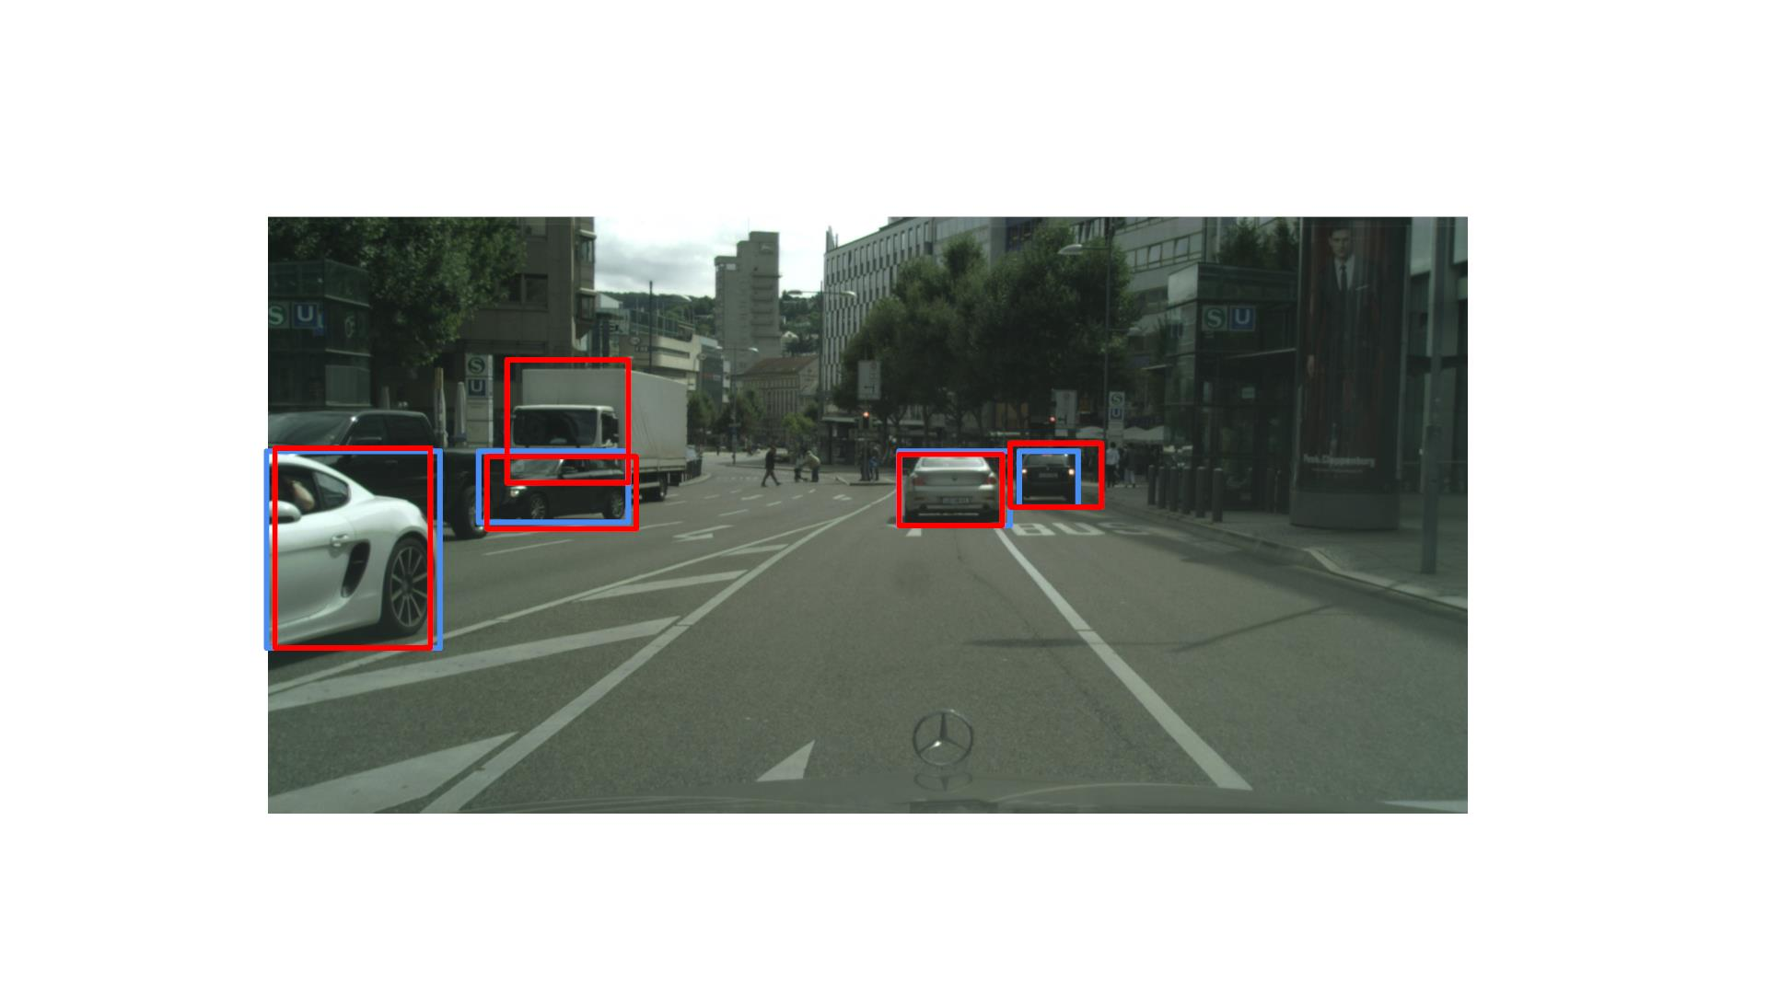
Example
0.7
0.9
0.88
0.78
0.99

Slide 10
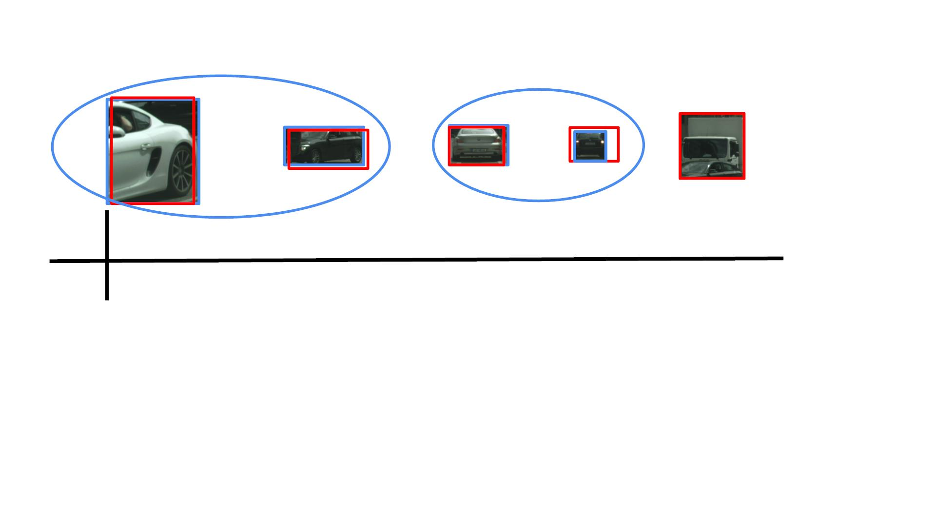
5番⽬は誤検知、この検知に対するground truth object（car）は存在しない。これはtruck
scoreはまだ低い。もし5番⽬の誤検知のscoreがScore Threshold以上であれば、FPに入るので、評価される。
Example
!"#$
0.99
0.9
0.9
0.88
0.8
0.78
0.3
0.7
0
%&' 0.95
• TP = 2
• Score Threshold: 0.9
• IOU Threshold: 0.7
• FP = 0
• FN = 2
• Precision = 2/2 = 1
• Recall = 2/4 = 0.5
The detector in this case is a high precision, low recall detector.
This means that the detector misses some objects in the scene, but when it does detect an object, it makes very few mistakes in category classification and bounding box location.

Slide 11
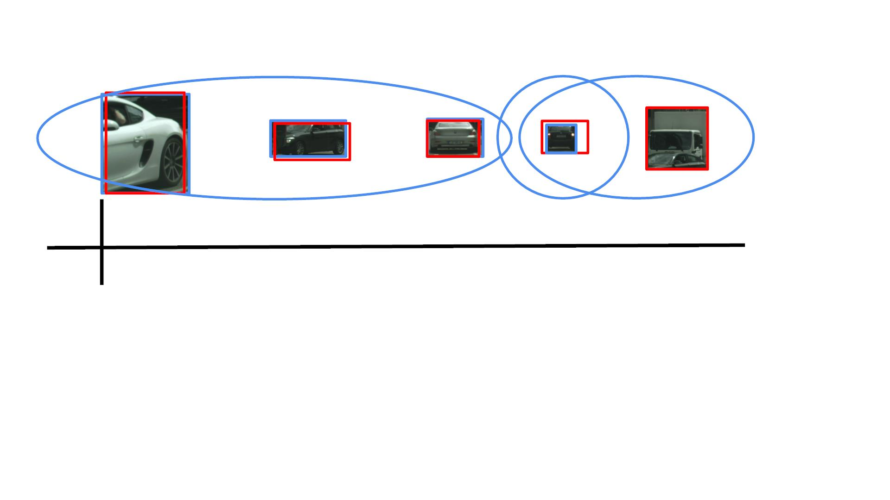
IOU未達なので、未検知（偽陰性）になる。またスコアが達したので、偽陽性にもなる。
Example
!"#$
0.99
0.9
0.9
0.88
0.8
0.78
0.3
0.7
0
%&' 0.95
• TP = 3
• Score Threshold: 0.7
• IOU Threshold: 0.7
• FP = 2
• FN = 1
• Precision = 3/5 = 0.6
• Recall = 3/4 = 0.75
TP+FNは全てのground truthの数
We can conclude that the effect of lowering the score threshold is less accurate detection results at the expense of detecting more objects in the scene.

Slide 12
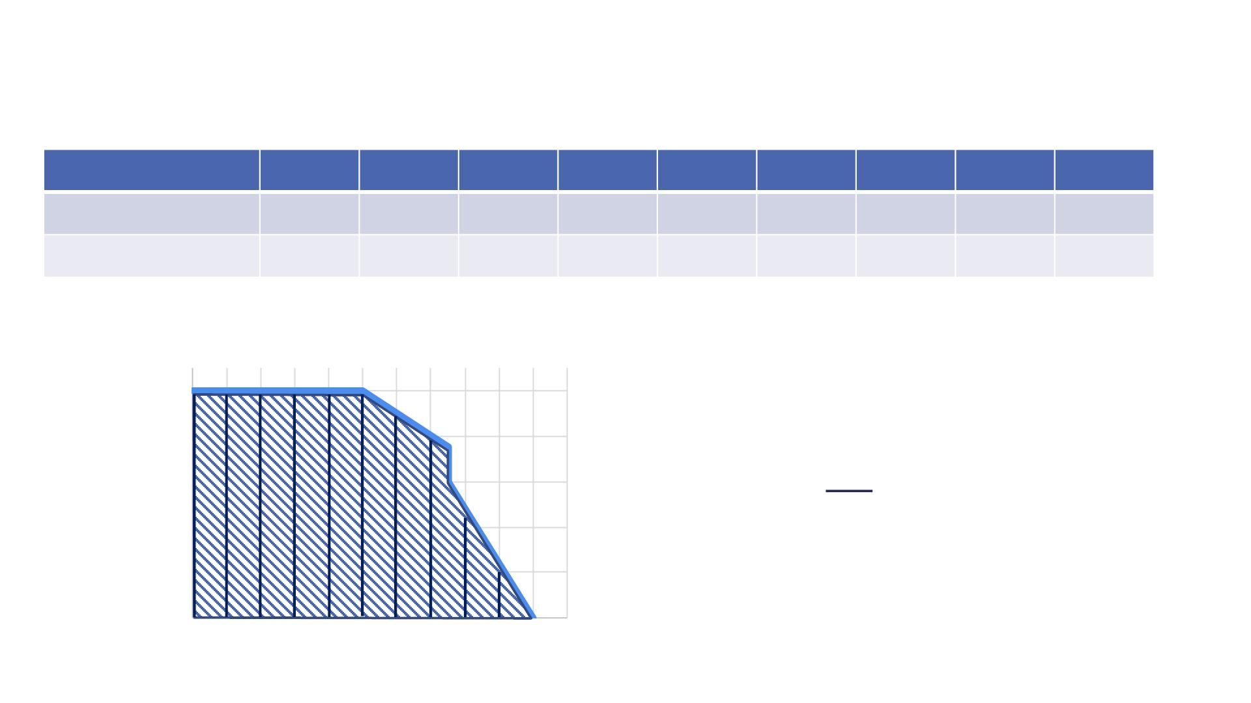
Note that we also add the precision, recall points of (1, 0) as the first point in the plot, and (0, 1) as the final point in the plot.
APの意味：The value of the average precision of the detector can be thought of as an average of performance over all score thresholds, allowing objective comparison of the performance of detectors without having to consider the exact score threshold that generated those detections.
Example
Score threshold 0.9 0.8 0.7 0.6 0.5 0.4 0.3 0.2 0.1
Precision
Recall
1
0.75 0.6
0.6
0.6
0.6
0.6
0.6
0.6
0.5
0.75 0.75 0.75 0.75 0.75 0.75 0.75 0.75
Precision-Recall Curve
1
0.8
0.6
0.4
0.2
0
$$
1
Precision
!" = % & ≈ 0.75
11
!
!"#
1+1+1+1+1+1+0.9+0.8+0.48+0.24+0=8.42
8.42 / 11 = 0.765になるが
0
0.1 0.2 0.3 0.4 0.5 0.6 0.7 0.8 0.9
1
1.1
Recall

Slide 13
Summary
• 2D object detection comprises of localizing an
object and determining what the object is
• 2D object detectors are evaluated using the Average
Precision metric, at a specific IOU threshold
• Next: 2D object detection using ConvNets
Implementation Resources from Google: https://github.com/tensorflow/models/tree/master/research/object_detection

Slide 14

2D Object Detection With Convolutional Neural
Networks
Course 3, Module 4, Lesson 2

Slide 15

The Object Detection Problem
Car
Truck
Pedestrian

Slide 16
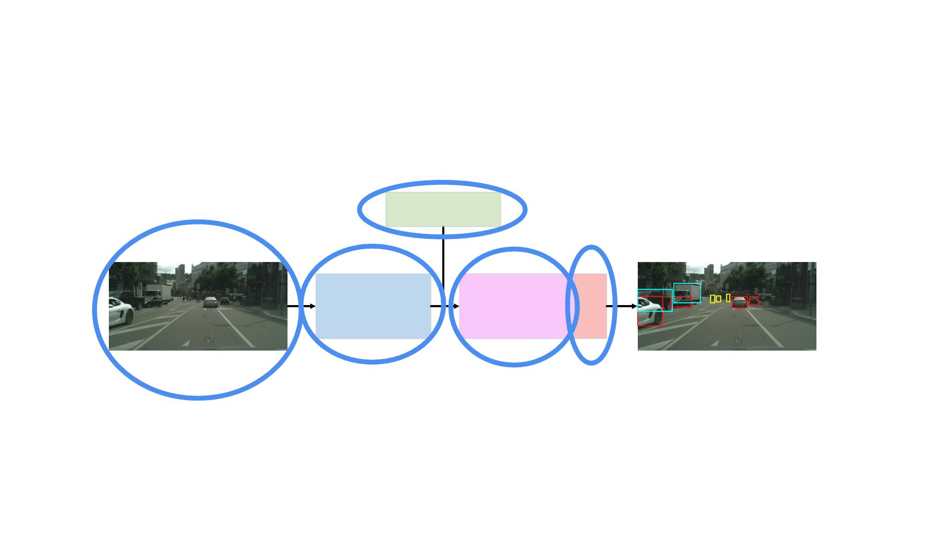
ConvNets For 2D Object Detection
Prior Boxes
Image
Output Detections
Feature Extractor
Output Layers NMS
The architecture takes as an input an image and a set of manually crafted prior（事前） boxes.
a set of fully connected layers take as an input, the output of the feature extractor and provide a location refinement of each 2D prior box as well as a classification.
non maximum suppression is performed on the output of the fully connected layers to generate the final detections.

Slide 17
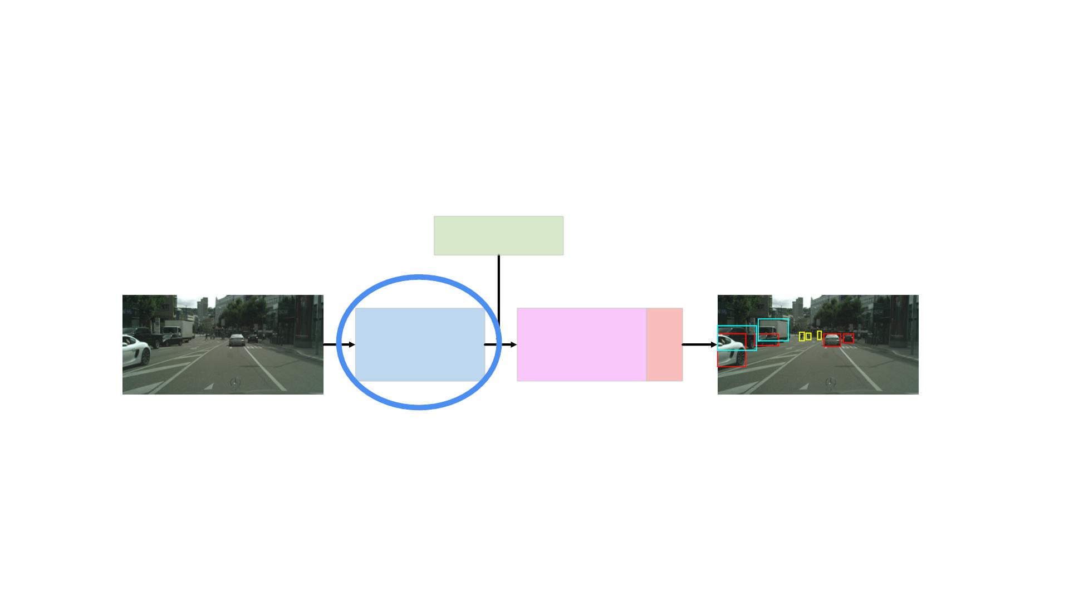
The Feature Extractor
Prior Boxes
Image
Output Detections
Feature Extractor
Output Layers NMS

Slide 18
The Feature Extractor
• Feature extractors are the most computationally
expensive component of the 2D object detector
• The output of feature extractors usually has much
lower width and height than those of the input
image, but much greater depth
• Very active area of research, with new extractors
proposed on regular basis
• Most common extractors are: VGG, ResNet, and
Inception
the output’s depth is usually two to three orders of magnitude greater than that of the input image.

Slide 19
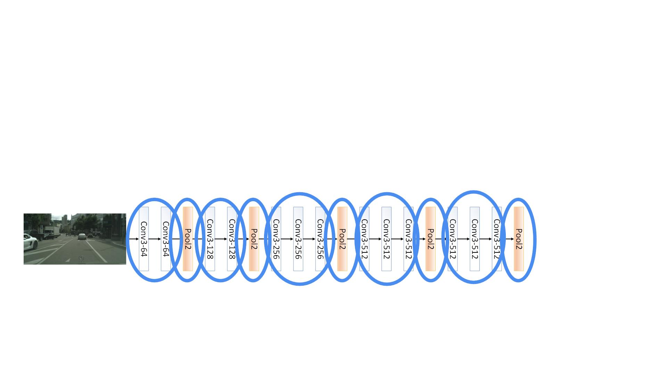
VGG Feature Extractor
• Alternating convolutional and pooling layers
• All convolutional layers are of size 3x3xK, with stride
1 and 1 zero-padding
• All pooling layers use the max function, and are of
size 2x2, with stride 2 and no padding

Slide 20

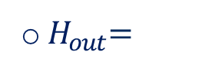
VGG Feature Extractor
つまりK個filter.
Kernelサイズは3x3.
Filterのchannel数はinputのchannel数と一致する。
•
All convolutional layers are of size 3x3xK, with stride 1 and 1 zero-padding
$ '()*×,
.%&'/)*×0
o ! =
%&
+ 1 =
+ 1 = !%&
!"#
-
0
. '()*×,
. '/)*×0
o $H_{out}$ =
%&
+ 1 =
%&
^{+ 1 = %}%&
-
0
o &!"# = '
• All pooling layers use the max function, and are of
size 2x2, with stride 2 and no padding.
$%&'(
$ ' *
$%&
1
.%&
o ! =
+ 1 =
%&
+ 1 =
!"#
-
*
. '(
. ' *
o % =
%&
+ 1 =
%&
+ 1 =
These particular hyperparameters were arrived at through intensive experimentation and have performed extremely well in a wide range of problems, making VGG an extremely popular extractor.
!"#
-
*
1
o &!"# = &%&

Slide 21
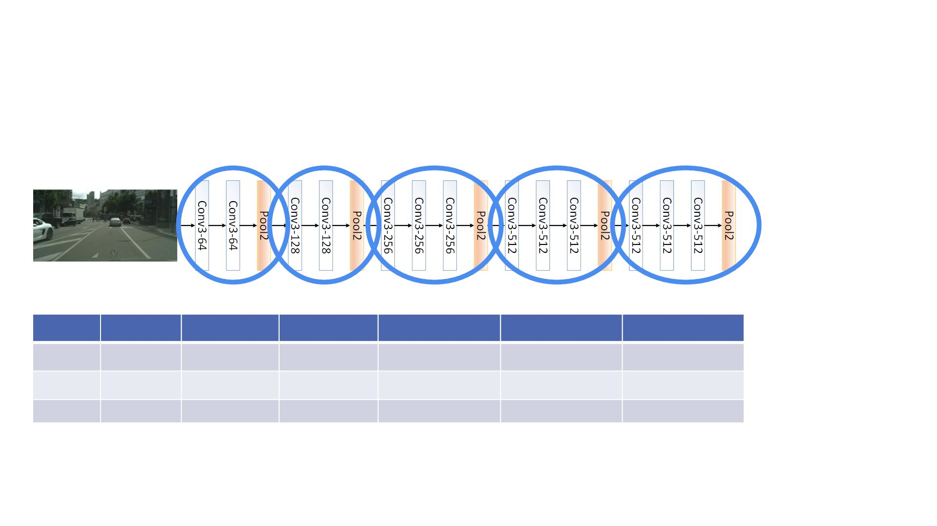
The Feature Extractor
Image
Conv1
M/2
N/2
Conv2
M/4
Conv3
M/8
Conv4
M/16
N/16
512
Conv5
M/32
N/32
512
Width
Height
Depth
M
N
3
N/4
N/8
64
128
256

Slide 22
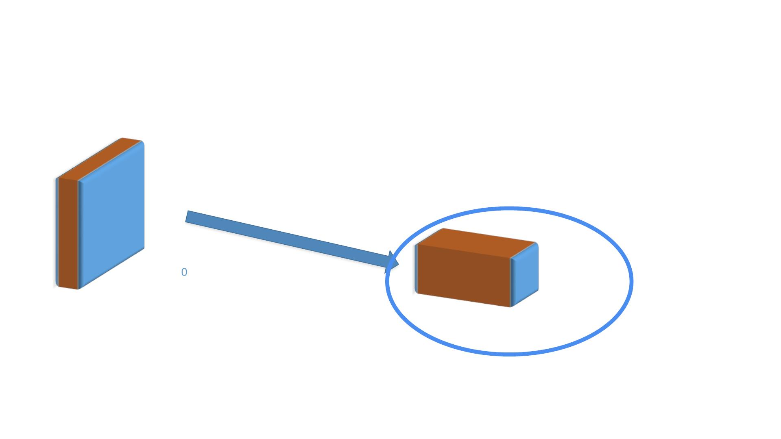
Output Volume Shape
Height = 960
Width = 124
Height = 30
Width = 40
Feature Extractor
Depth = 3
Depth = 512

Slide 23
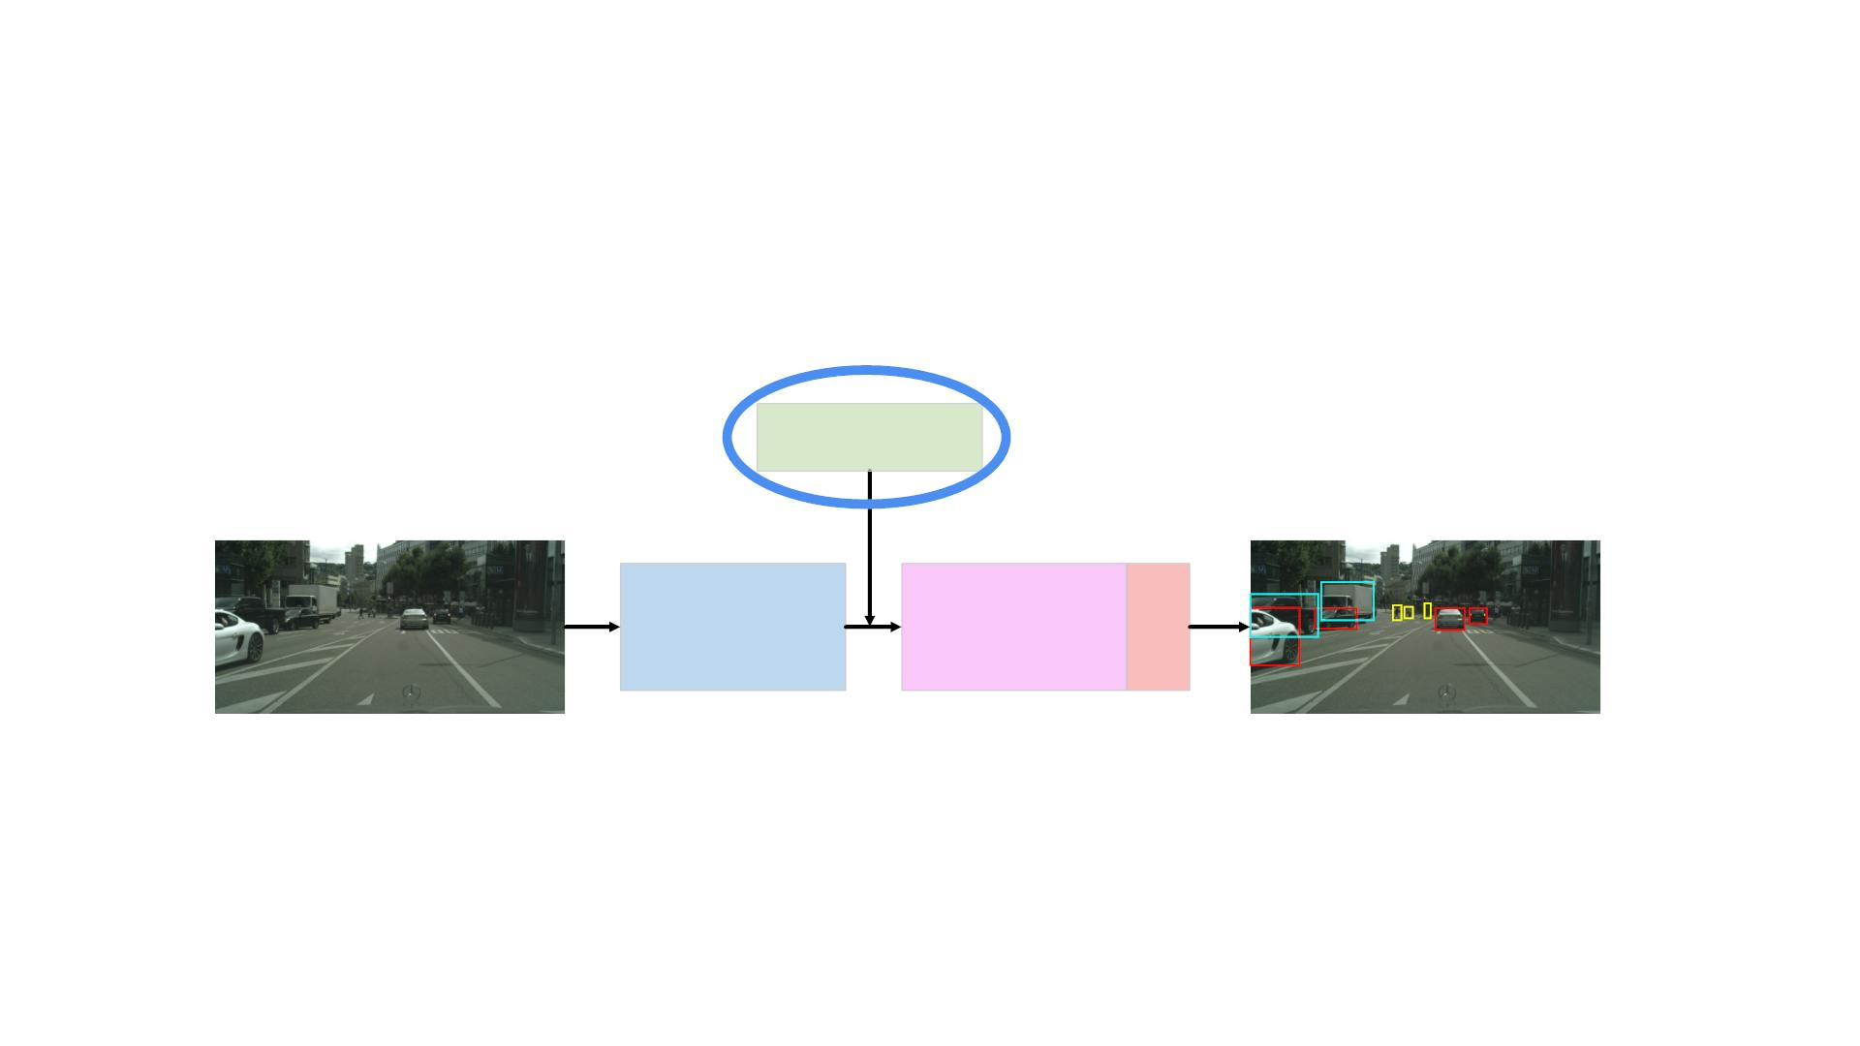
Prior/Anchor Bounding Boxes
Prior Boxes
Image
Output Detections
Feature Extractor
Output Layers NMS

Slide 24
To generate 2D bounding boxes, we usually do not start from scratch and estimate the corners of the bounding box without any prior.
We assume that we do have a prior on where the boxes are in image space and how large these boxes should be.
Anchor boxes are manually defined over the whole image usually on an equally-spaced grid.

Slide 25
Let’s assume that we have a set of anchors close to our ground-truth boxes.

Slide 26
This is termed residual learning and it takes advantage of the notion that it is easier to nudge an existing box a small amount to improve it rather than to search the entire image for possible object locations.
In practice, residual learning has proven to provide much better results than attempting to directly estimate bounding boxes without any prior.
During training, the network learns to take each of these anchors and tries to move it as close as possible to the ground-truth bounding box in both the centroid location and box dimensions.

Slide 27
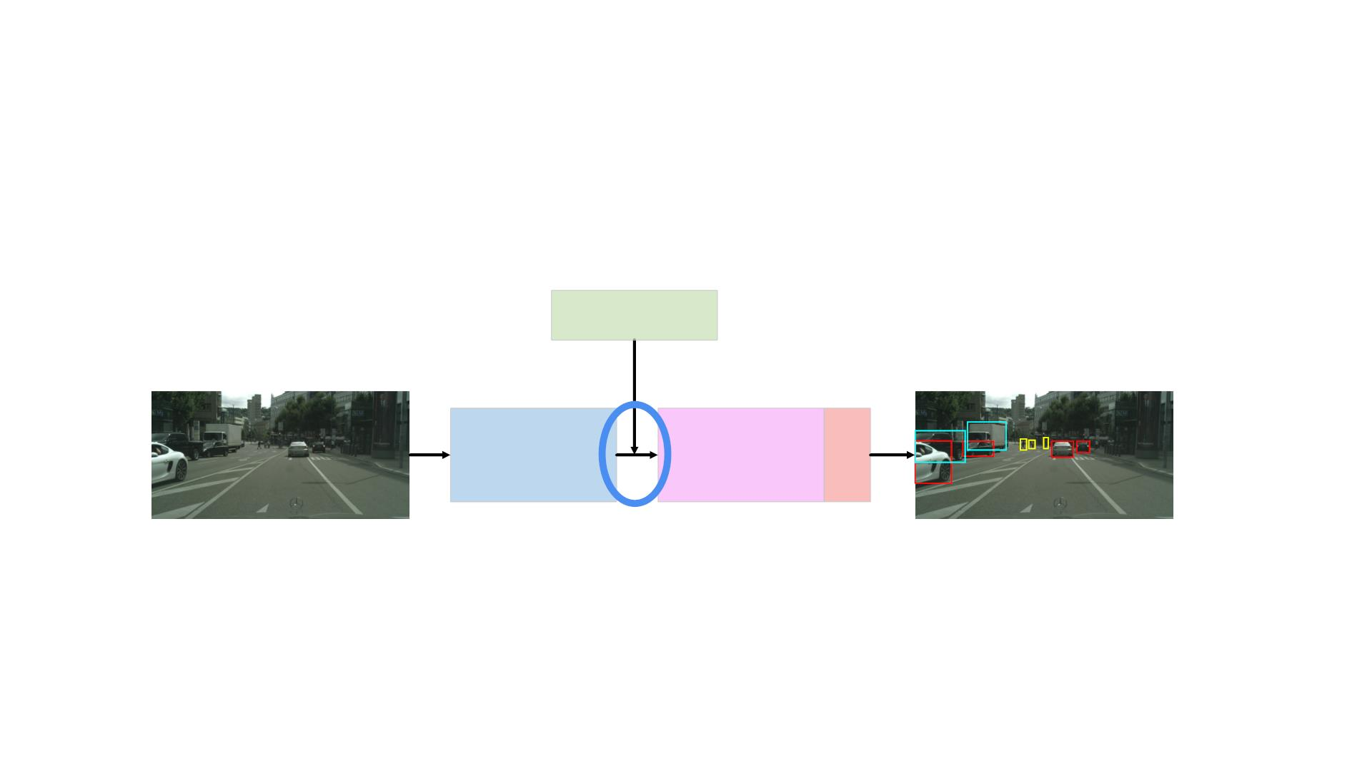
Prior/Anchor Bounding Boxes
Prior Boxes
Image
Output Detections
Feature Extractor
Output Layers NMS
Many different methods have been proposed in the literature on how to use the anchor bounding boxes to generate the final prediction.
Usually, the anchors interact with the feature map to generate fixed sized feature vectors for every anchor. （次のスライドから）
つまりanchorsはVGGの最後の40*30*512のfeature mapと連携する。

Slide 28
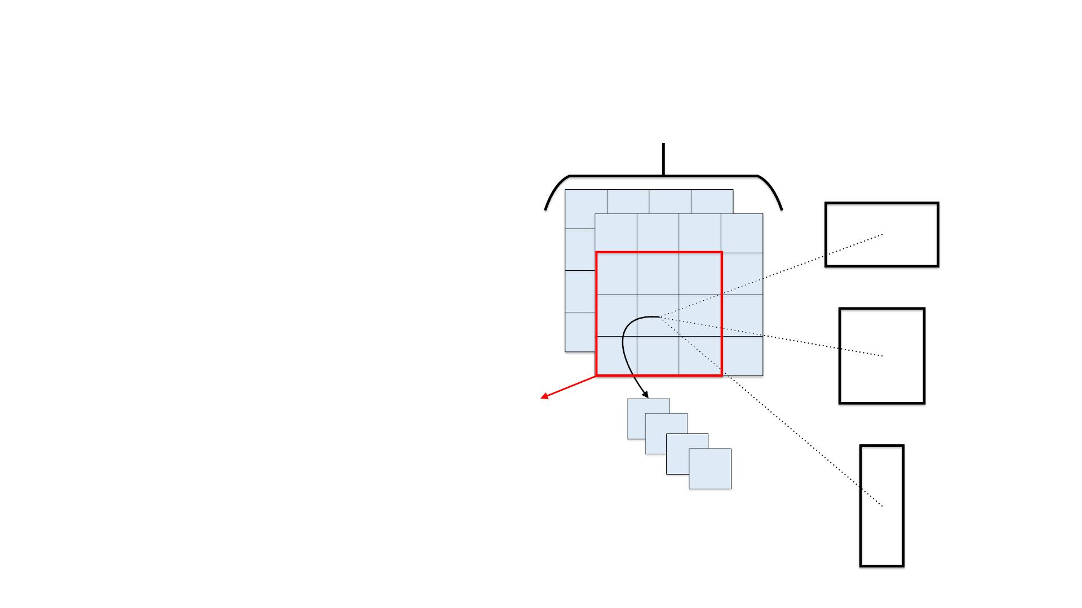
Using Anchor Boxes
論文には3 scale, 3 aspect ratioの組み合わせの9 anchorsをディフォルトで使う。
Ren, Shaoqing, et al. "Faster r-cnn: Towards real-time object
detection with region proposal networks." Advances in neural
information processing systems. 2015
MMM xxx NNN x D FFFeeeaaatttuuurrreee MMMaapp
https://arxiv.org/abs/1506.01497
kk AAAnnncchhhoorr BBBoooxxxeeesss
For every pixel in the feature map, we associate k anchor boxes.
Then perform a 3x3xD* convolution operation on that pixel’s neighborhood. このconvolutionは別にanchor boxと関係ないと思う。
This results in a 1x1xD* feature vector for that pixel.
We use this 1x1xD* feature vector as the feature vector of every one of the anchors associated with that pixel. K anchorsは同じfeature vectorを持っていると思う。
33xx33xxDD**
ccoonnvvoolluuttiioonn
次のLessonから分かる。
1 x 1 x D* Per-Anchor
Feature Vector

Slide 29
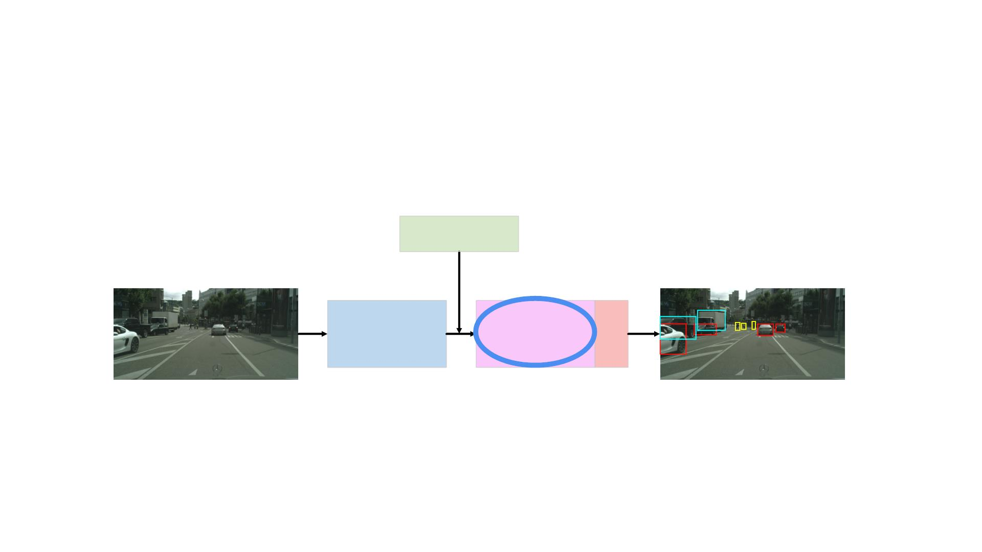
Output Layers
Prior Boxes
Image
Output Detections
Feature Extractor
Output Layers NMS
We then proceed to feed the extracted feature vector to the output layers in the neural network.

Slide 30
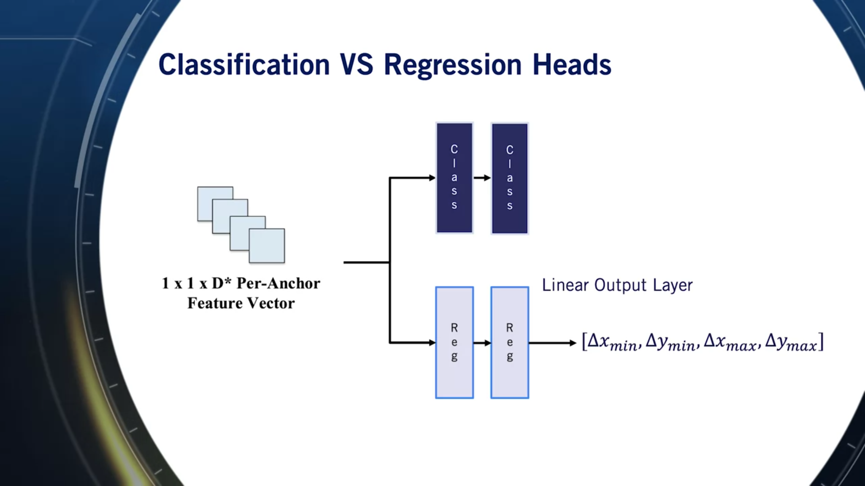
The output layers of a 2D object detector usually comprise of a regression head and a classification head.
The regression head usually includes multiple fully-connected hidden layers with a linear output layer.
The regressed output is typically a vector of residuals that need to be added to the anchor at hand to get the ground truth bounding box.
つまり、anchor boxesのサイズはまだ調整していない。まだpriorのまま。
このresidual（残余）を使ってbounding boxのサイズを調整するんだ！
つまりこの⽅法はanchor boxのcentroidを気にしなく、ただanchor boxの4つ点を移動するんだ。

Slide 31
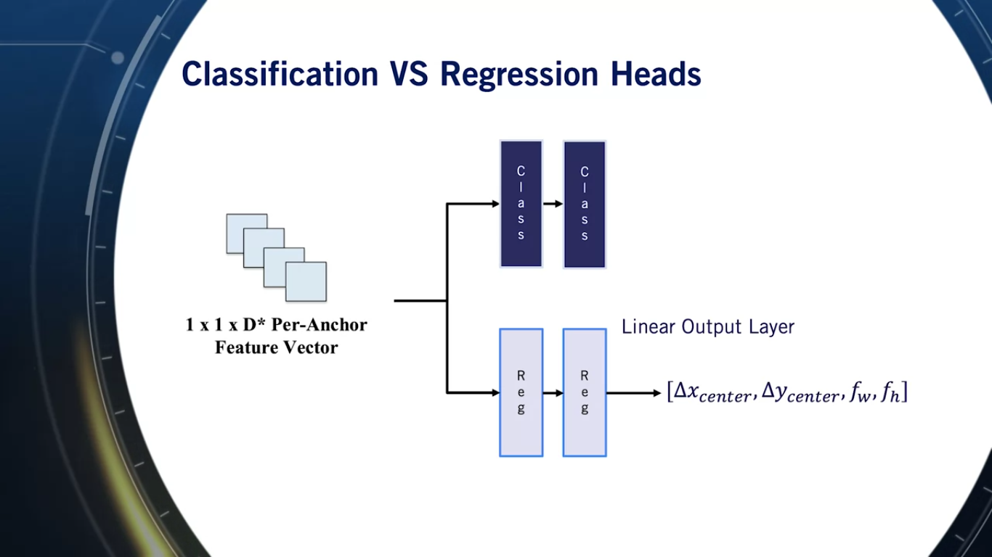
Another method to update the dimension of the anchors is to regress a residual from the center of the anchor to the center of the ground truth bounding box in addition to two scale factors that correct the ground truth bounding box width and height when multiplied with an anchor’s width and height.
前スライドの⽅法はanchor boxの4つ頂点を移動する。この⽅法はanchor boxの中⼼点を移動して、また⾼さと幅をscaleする。

Slide 32
The classification head is also comprised of multiple fully-connected hidden layers, but with a final softmax output layer. 分類だから。
The softmax output is a vector with a single score per class.
The highest score usually defines the class of the anchor at hand.
Feature mapのpixel単位（かつanchor単位）で分類＆回帰している？

Slide 33
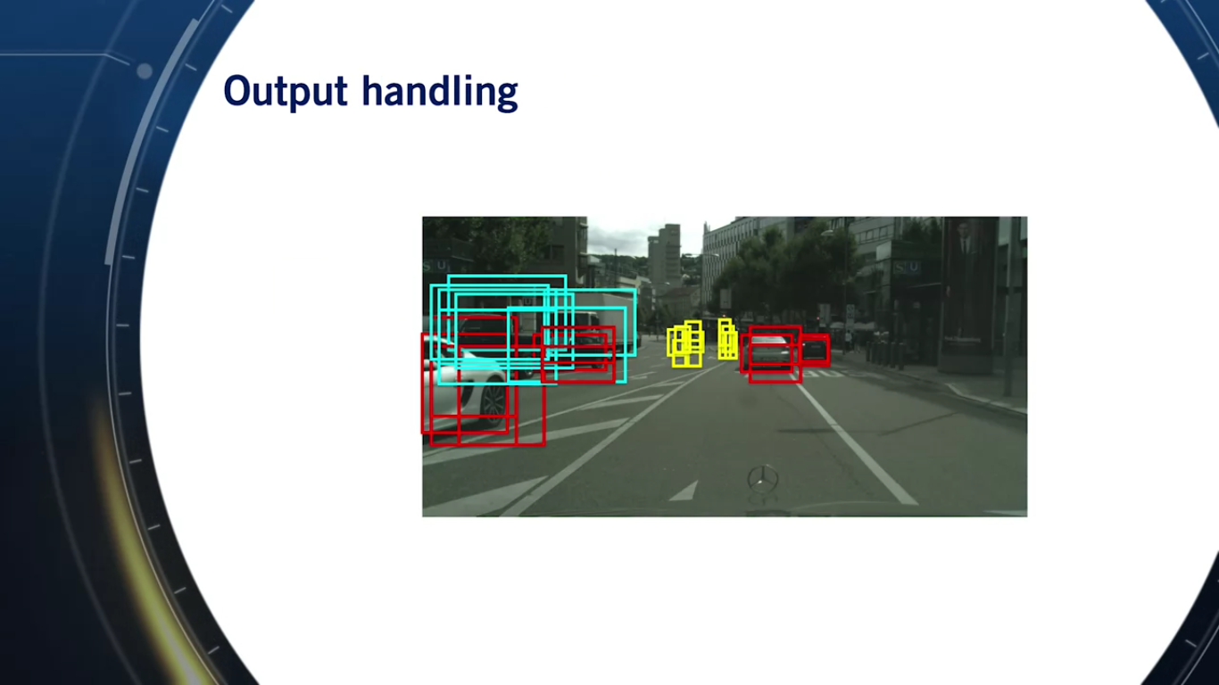
Redundant Bounding Boxesの解決策（まだ終わっていない、次のLessonへ）
We will end up with k bounding boxes per pixel of the output feature map.
Even if we consider boxes with high classification score for all classes of interest, we still will have many redundant detections in the image.
bounding boxesが多すぎるので、ほとんど重なって、⾼い点数を得るのはよくあるからでしょう。
During average precision computation, we only consider one detection per ground truth bounding box.
Any redundant detections are considered false positives and results in lower precision and thus a lower average precision overall. Precisionの分母はFT+FPだから。
In fact, this is only an issue of inference and it turns out to be beneficial to drive the network to output the best possible residuals for every anchor during training.

Slide 34
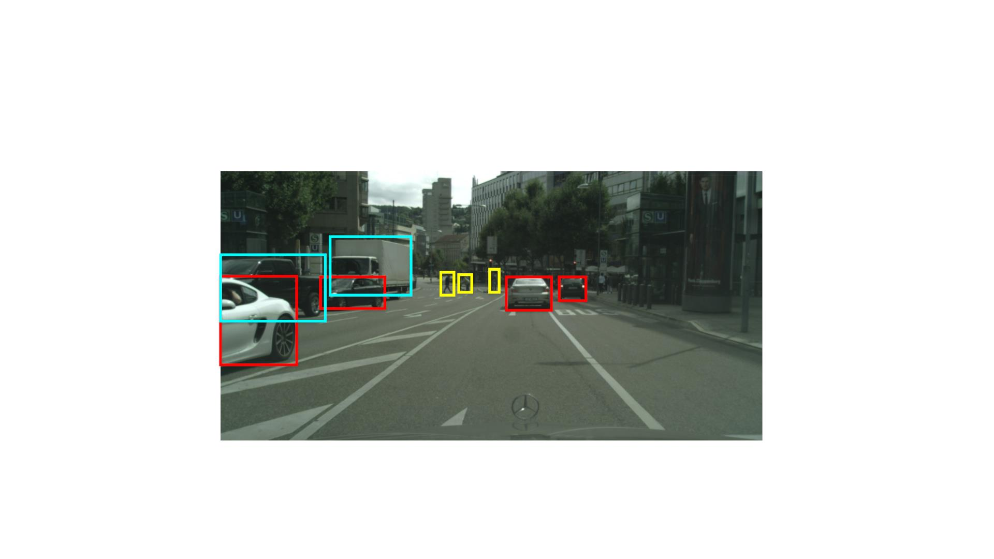
Output handling

Slide 35
Summary
• 2D object detectors can be performed using
convolutional neural networks
• Usually, anchor boxes are used as priors for the
neural network to shift around to achieve object
classification and localization
• Next: Training vs Inference

Slide 36
Training Vs Inference
Course 3, Module 4, Lesson 3

Slide 37
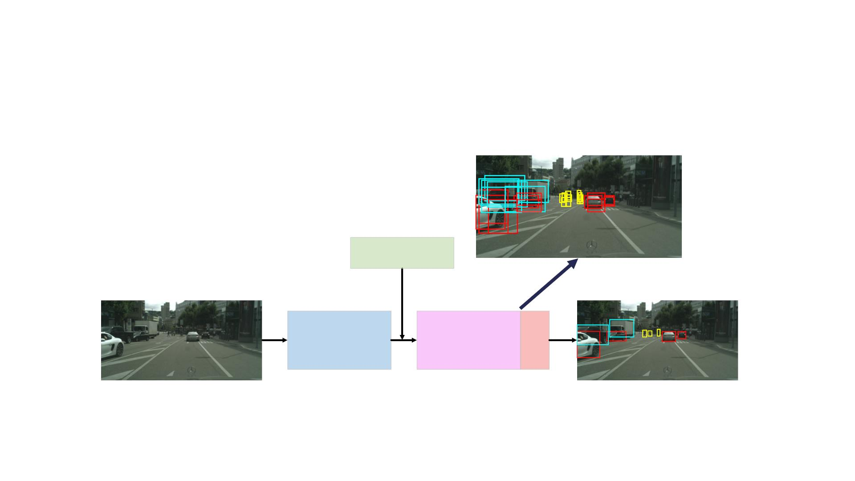
ConvNets For 2D Object Detection
Prior Boxes
Image
Output Detections
Feature Extractor
Output Layers NMS

Slide 38
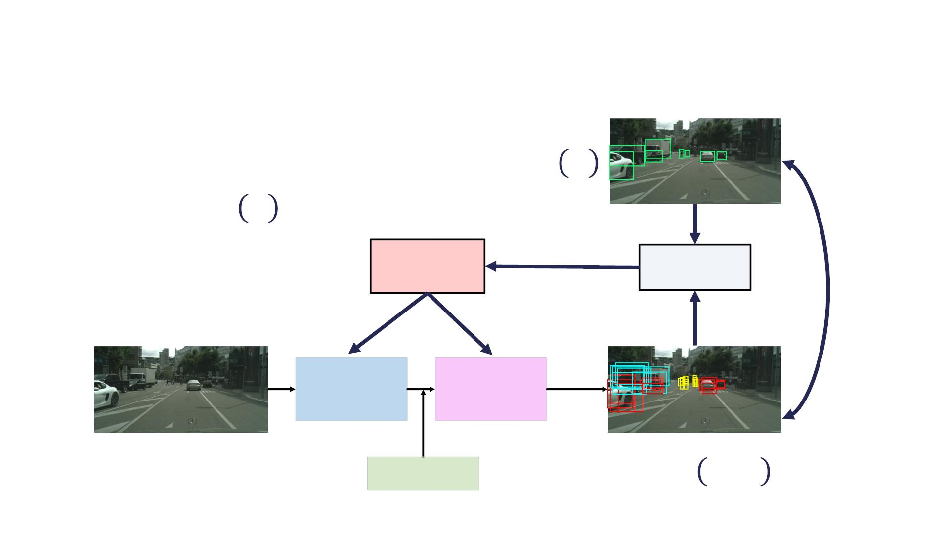
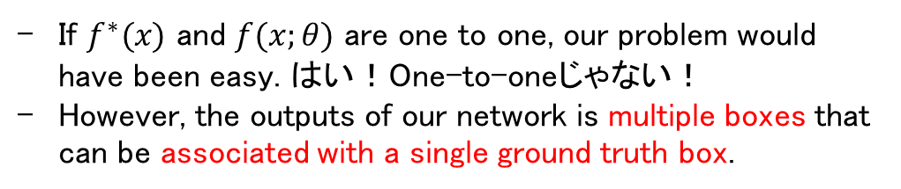
If $f^{∗}(x)$ and $f(x;θ)$ are one to one, our problem would have been easy. はい！One-to-oneじゃない！
However, the outputs of our network is multiple boxes that can be associated with a single ground truth box.
2D Object Detector Training
*+,-'-'. /,0,
#∗ $
[$, #∗ $ ]
Optimization
Loss Function
&'()
Feature Extractor
Output Layers
$
! = # $; &
Prior Boxes

Slide 39
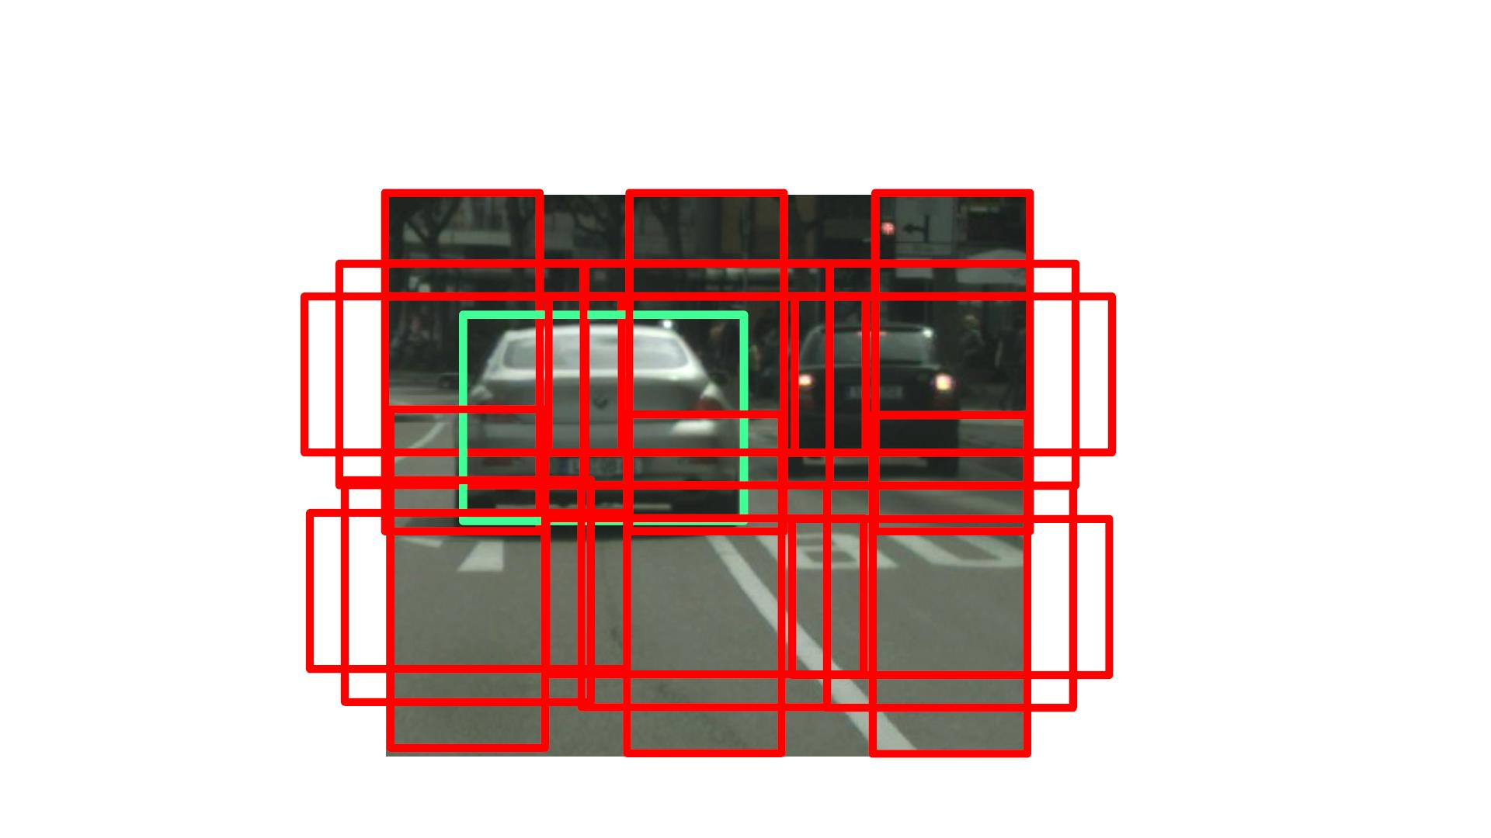
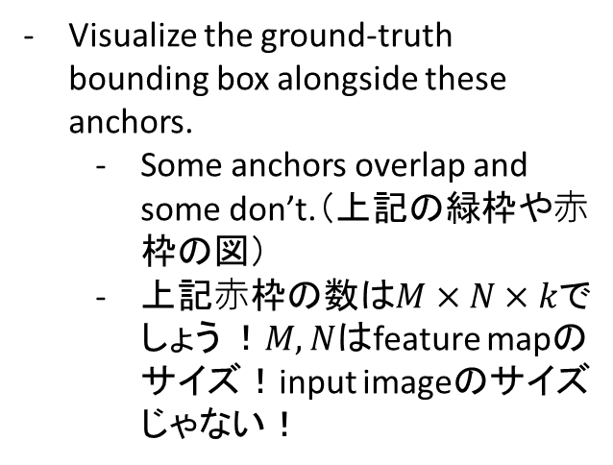
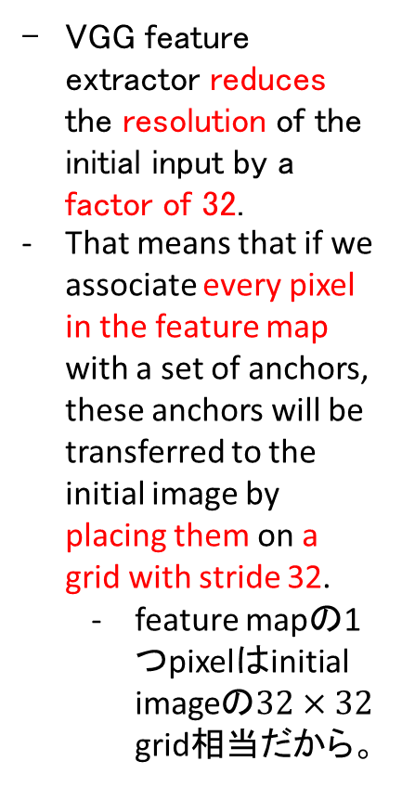
Visualize the ground-truth bounding box alongside these anchors.
Some anchors overlap and some don’t.（上記の緑枠や⾚枠の図）
上記⾚枠の数は$M×N×k$でしょう ！$M, N$はfeature mapのサイズ！input imageのサイズ じゃない！
MiniBatch Selection
VGG feature extractor reduces the resolution of the initial input by a factor of 32.
That means that if we associate every pixel in the feature map with a set of anchors, these anchors will be transferred to the initial image by placing them on a grid with stride 32.
feature mapの1つpixelはinitial imageの$32×32$ grid相当だから。

Slide 40
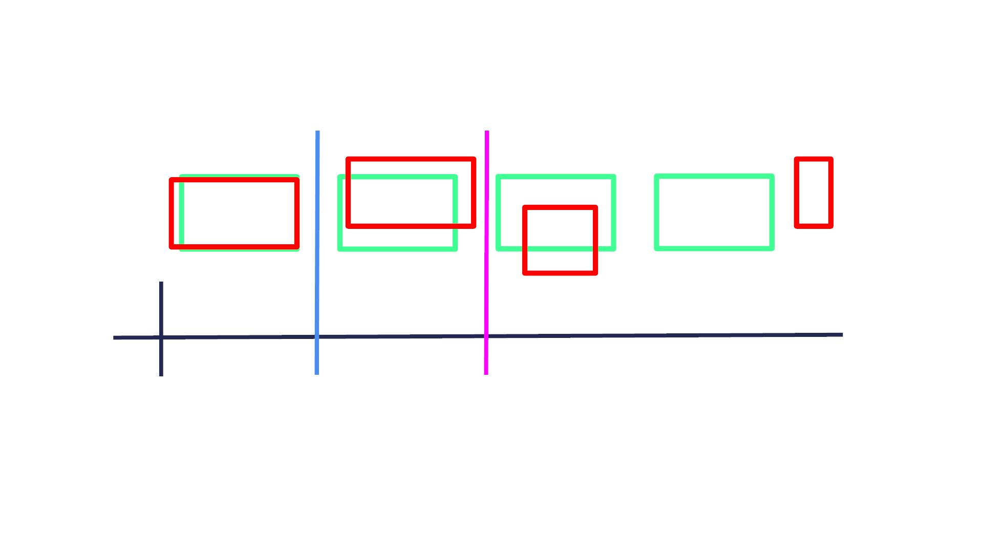
MiniBatch Selection
IOU
0.8
0.5
0.3
0
Any anchor with an IOU greater than the positive anchor threshold is called a positive anchor.
Any anchor with an IOU less than the negative anchor threshold is called a negative anchor.
Any anchor with an IOU in between the two thresholds is fully discarded. すごい！
• Negative Member Threshold: < 0.4
• Positive Member Threshold: > 0.6

Slide 41
Minibatch Selection
• Negative anchors target:
o Classification: Background
o Regression: None
Background is usually a class we add to our classes of interest to describe anything not included in these classes.
• Positive anchors target:
o Classification: Category of the ground truth bounding box
o Regression: Align box parameters with highest IOU ground
truth bounding box
ここのanchorはprior anchorsだと思う。

Slide 42
Minibatch Selection
The proposed IOU thresholding mechanism results in most of the regressed anchors being negative anchors.
When training with all these anchors, the network will be observing far more negative than positive examples leading to a bias towards the negative class.
• Problem: Majority of anchors are negatives results in
neural network will label all detections as background
• Solution: Sample a chosen minibatch size, with 3:1
ratio of negative to positive anchors to eliminate bias
towards the negative class
• Choose negatives with highest classification loss (online
hard negative mining) to be included in the minibatch
This means we will be training to fix the biggest errors in negative classification.
• Example: minibatch size is 64à 48 hardest negatives
and 16 positives
迷った。Minibatchのサイズは画像の枚数だよね？Negatives, positivesのサイズはanchorの数だよね？多分minibatchは選ばれたanchorsの話だと思う。一枚画像に3:1だったら、どんなサイズのminibatchもnegatives, positivesは3:1になるでしょう！論文によると、minibatchの一枚画像の話だ（Each mini-batch arises from a single image that contains many positive and negative example anchors.）
If the number of positives is less than 16, we either copy some of the positives to pad the minibatch or fill the remaining spots with negative anchors.

Slide 43

Classification Loss
1
! =
∗
% &'())*+,'(-.() , ) )
!"#
$$%$&"
' '
'
• ! is the size of our minibatch
• " is the output of the neural network
• " is the anchor classification target:
The total classification loss is the average of the cross-entropy loss of all anchors in the minibatch.
$%$&"
'
∗
'
o Background if anchor is negative
o Ground truth box class if anchor is positive

Slide 44

Regression Loss
1
∗
! = % & ! (( , ( )
!"#
$
% & % %
$
%
We only attempt to modify an anchor if it is a positive anchor.
• ! is 0 if anchor is negative and 1 if anchor is positive
+
• " is the number of positive anchors in the minibatch
,
∗
• # is the ground truth bounding box
+
• # is the estimated bounding box, applying the
上記の「Classification VS Regression Heads」を参考
+
regressed residuals to the anchor box parameters

Slide 45
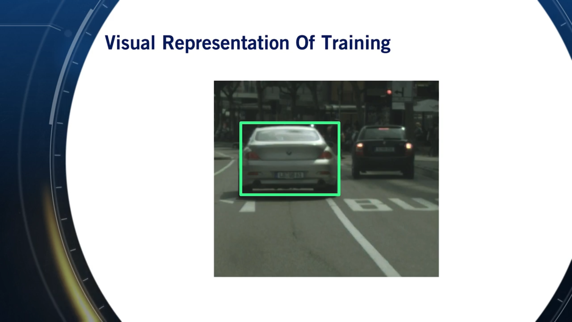

Slide 46
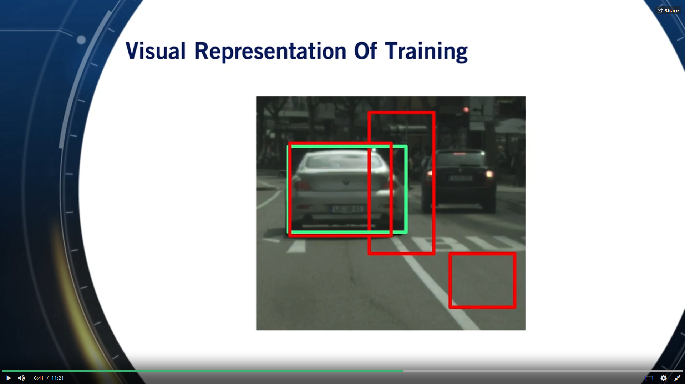
Given an input image, a ground truth bounding box, and a set of input anchors from the anchor prior,

Slide 47
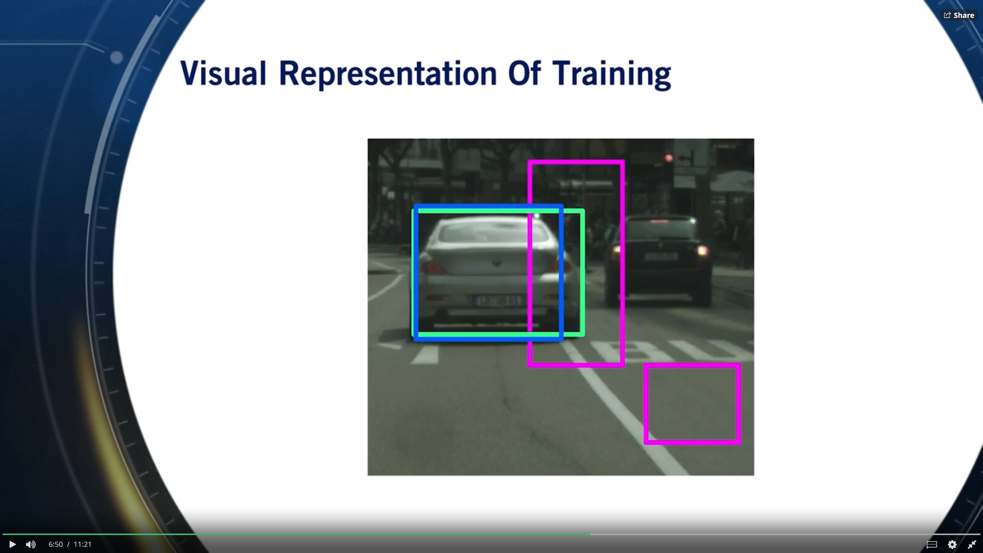
We are teaching the neural network to classify anchors as containing background in purple or a car in blue.
This is done by minimizing the cross entropy loss.

Slide 48
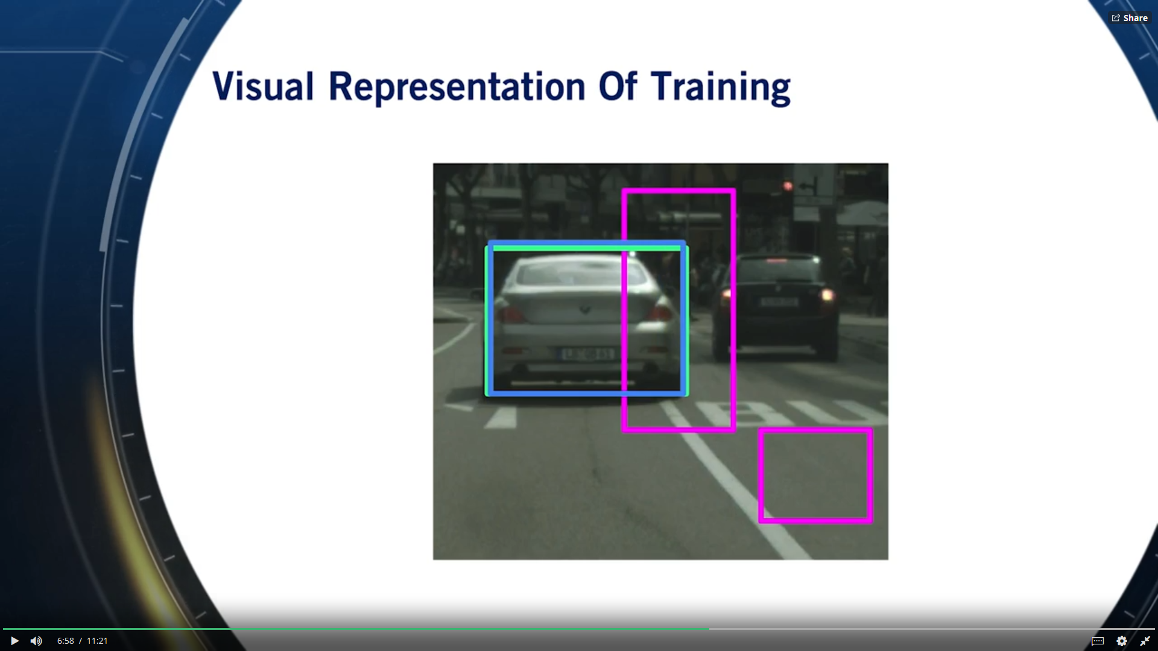
- Then we want the neural network to move only anchors that contain a class of interest, in a way that matches the closest ground truth bounding box.

Slide 49
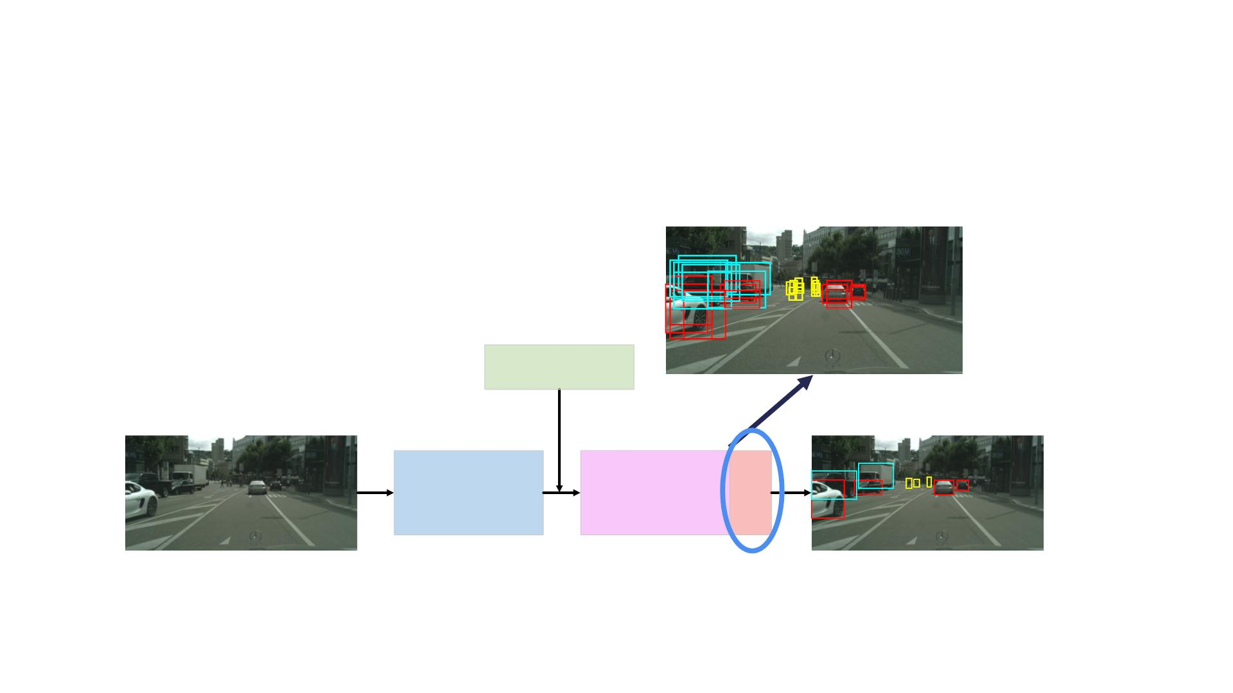
Inference Time
Prior Boxes
Image
Output Detections
Feature Extractor
Output Layers NMS

Slide 50
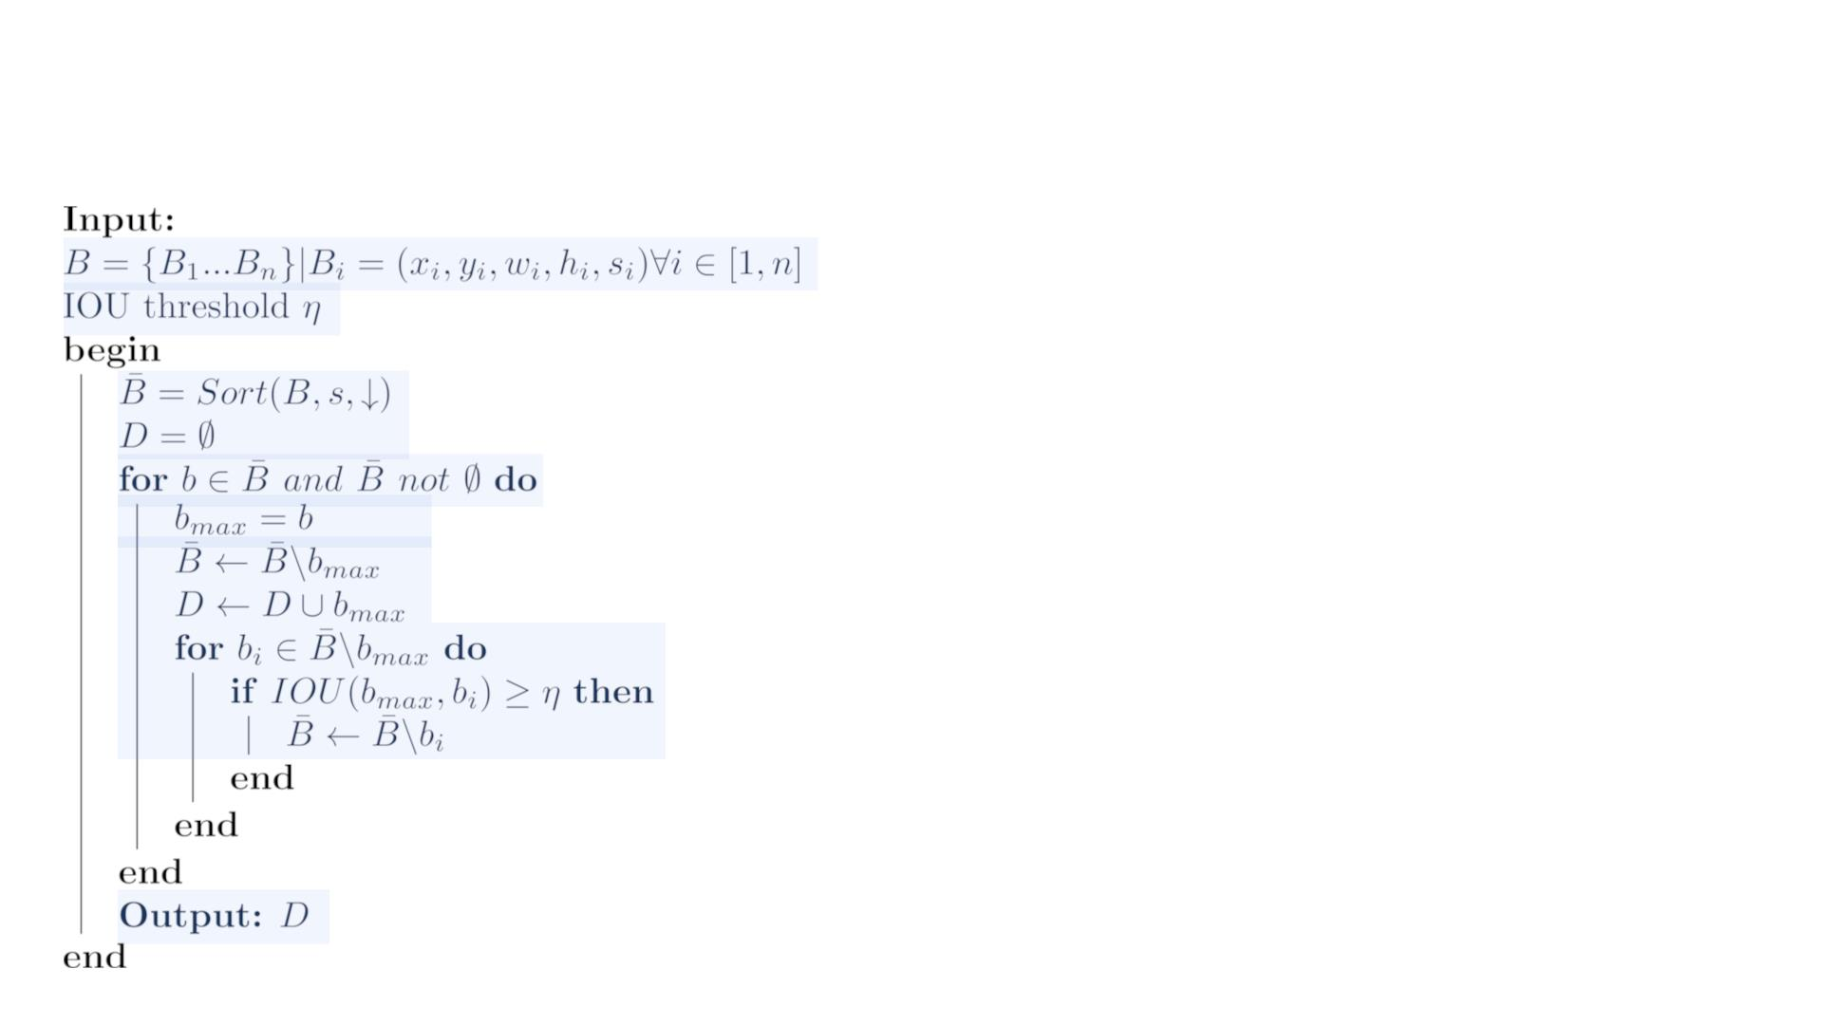
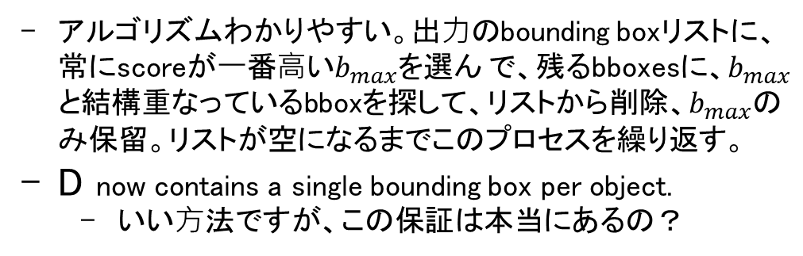
Non-Maximum Suppression
アルゴリズムわかりやすい。出⼒のbounding boxリストに、常にscoreが⼀番⾼い$b_{max}$を選ん で、残るbboxesに、$b_{max}$と結構重なっているbboxを探して、リストから削除、$b_{max}$のみ保留。リストが空になるまでこのプロセスを繰り返す。
D now contains a single bounding box per object.
いい⽅法ですが、この保証は本当にあるの？

Slide 51
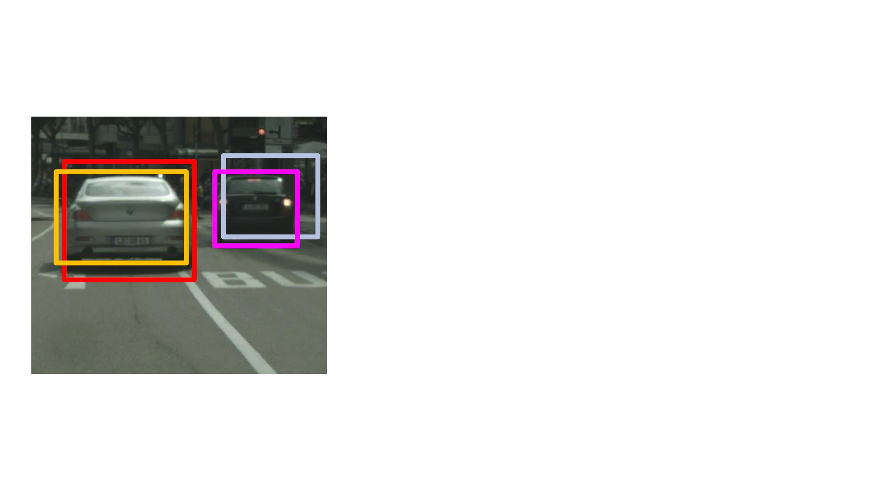
Non-Maximum Suppression
≥ & = 0.7
3 = {$ , $ , $ , $ }
$ % & '
2
3 = {$ , $ , $ , $ }
$ % & '
+ = {0.98,0.94,0.6,0.45}
0.8
4 = { }
! = {$ }
!"#
$

Slide 52
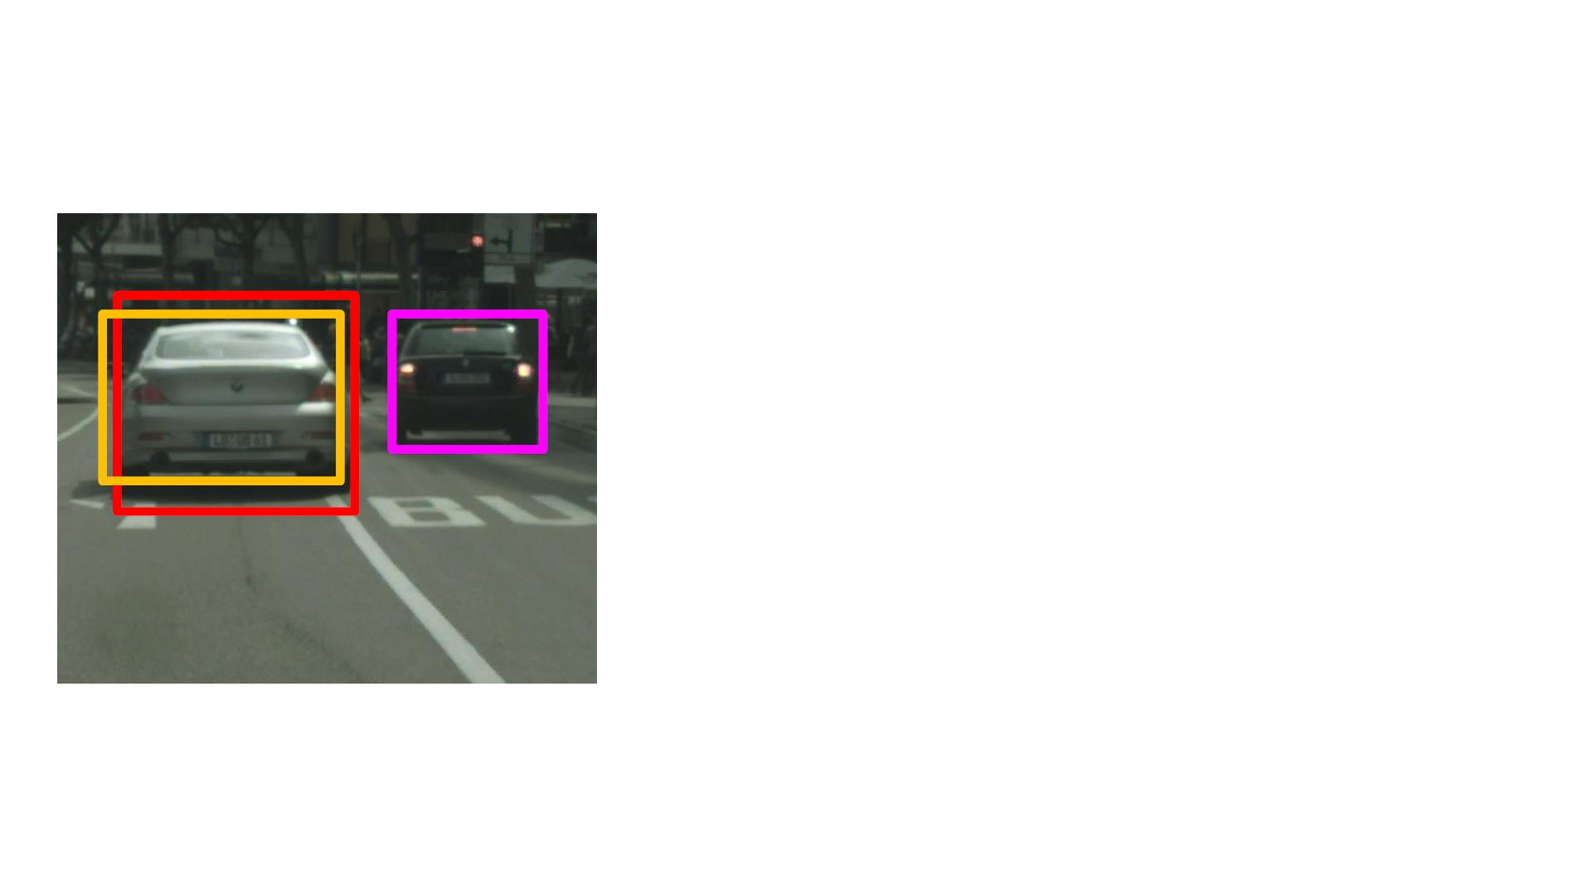
Non-Maximum Suppression
≥ ! = 0.7
1 = {) , ) , ) , ) }
& $ ' %
0
1 = {) , ) }
$ %
+ = {0.94,0.45}
2 = {)&}
0.72
' = {) }
!"#
$

Slide 53
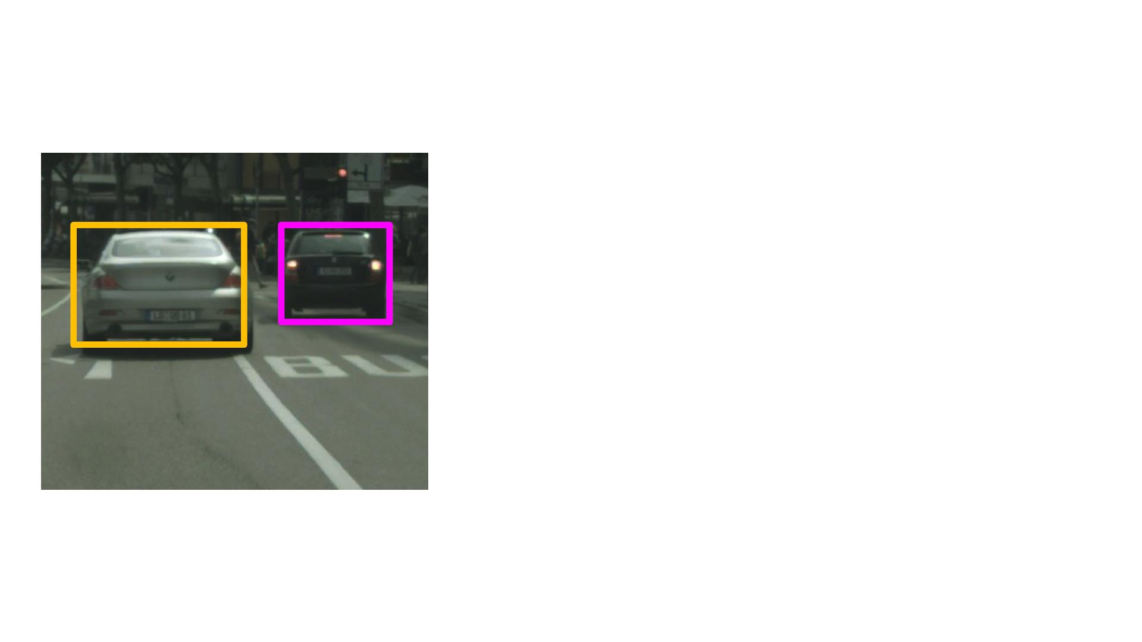
Non-Maximum Suppression
! = 0.7
, = {( , ( , ( , ( }
% $ & '
+
, = {}
* = {}
- = {( , ( }
% $
& = {( }
!"#
$

Slide 54
Summary
• To train a neural network for 2D object detection, use
minibatch selection on anchors
to maintain class balance.
学習中redundant bounding boxは本当にnegativeになってる？
• For inference, use Non-Maximum Suppression（抑制） to get a
single output bounding box per object
• Next: Using 2D object detectors for autonomous driving
[2015] SSD: Single Shot MultiBox Detector: https://arxiv.org/abs/1512.02325
[2016] Faster R-CNN: Towards Real-Time Object Detection with Region Proposal Networks: https://arxiv.org/abs/1506.01497
[2017] Focal Loss for Dense Object Detection: https://arxiv.org/abs/1708.02002
時間探して読もう！

Slide 55
Using 2D Object Detectors for Self-Driving
Perception
Course 3, Module 4, Lesson 4

Slide 56
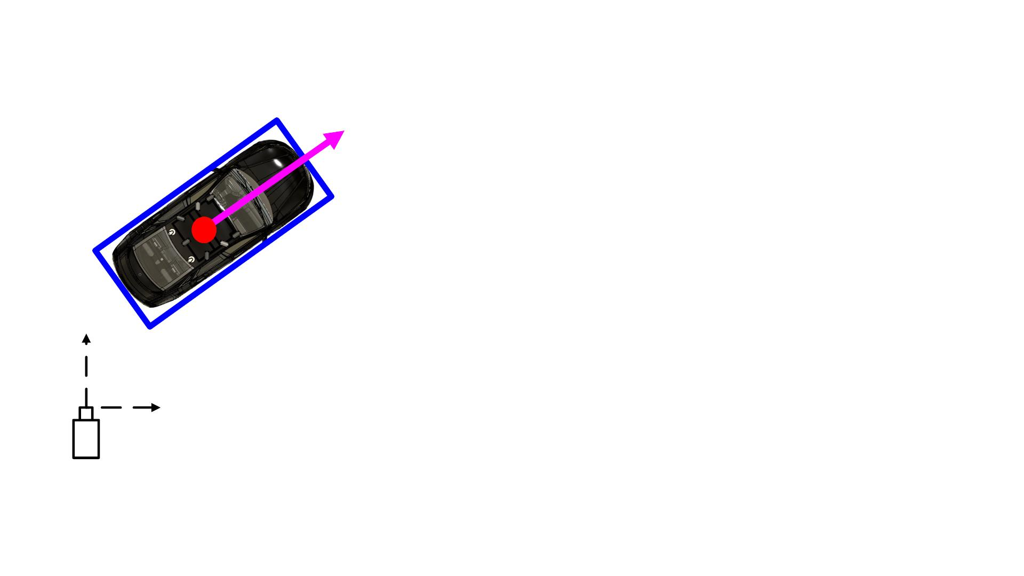
3D Object Detection
• Estimating the:
o Category Classification
o Position of the centroid in 3D
o Extent in 3D
2Dのbounding boxと似てる
o Orientation in 3D
orientation angles. roll, pitch, yaw.
For road scenes, the orientation angle we are interested in is usually only the yaw angle.
Y
X

Slide 57
3D Object Detection
• Estimate the:
o Car, pedestrian, cyclist
o [", $, %]
o [', (, ℎ]
o [*, +, ,]
Y
X

Slide 58
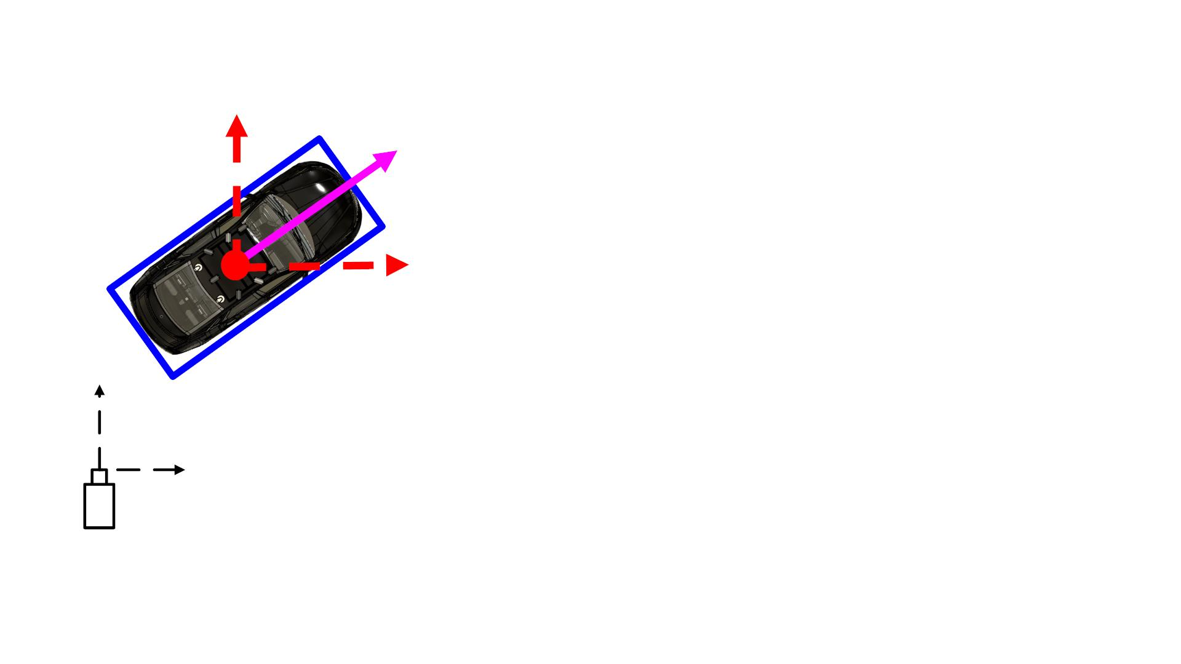
3D Object Detection
• Estimate the:
o Car, pedestrian, cyclist
o [", $, %]
!
o [', (, ℎ]
o [*, +, ,]
Y
X

Slide 59
The most common and successful way to extend 2D object detection results in 3D is to use LiDAR point clouds.
Given a 2D bounding box in an image space and a 3D LiDAR point cloud, we can use the inverse of the camera projection matrix to project the corners of the bounding box as rays into the 3D space.
The polygon intersection of these lines is called a frustum（錐台「すいだい」）, and usually contains points in 3D that correspond to the object in our image. つまりraysとpoint cloudのintersection.
We then take the data in this frustum from the LiDAR, transform it to a representation of our choice, and train a small neural network to predict the seven parameters required to define our bounding box in 3D.

Slide 60
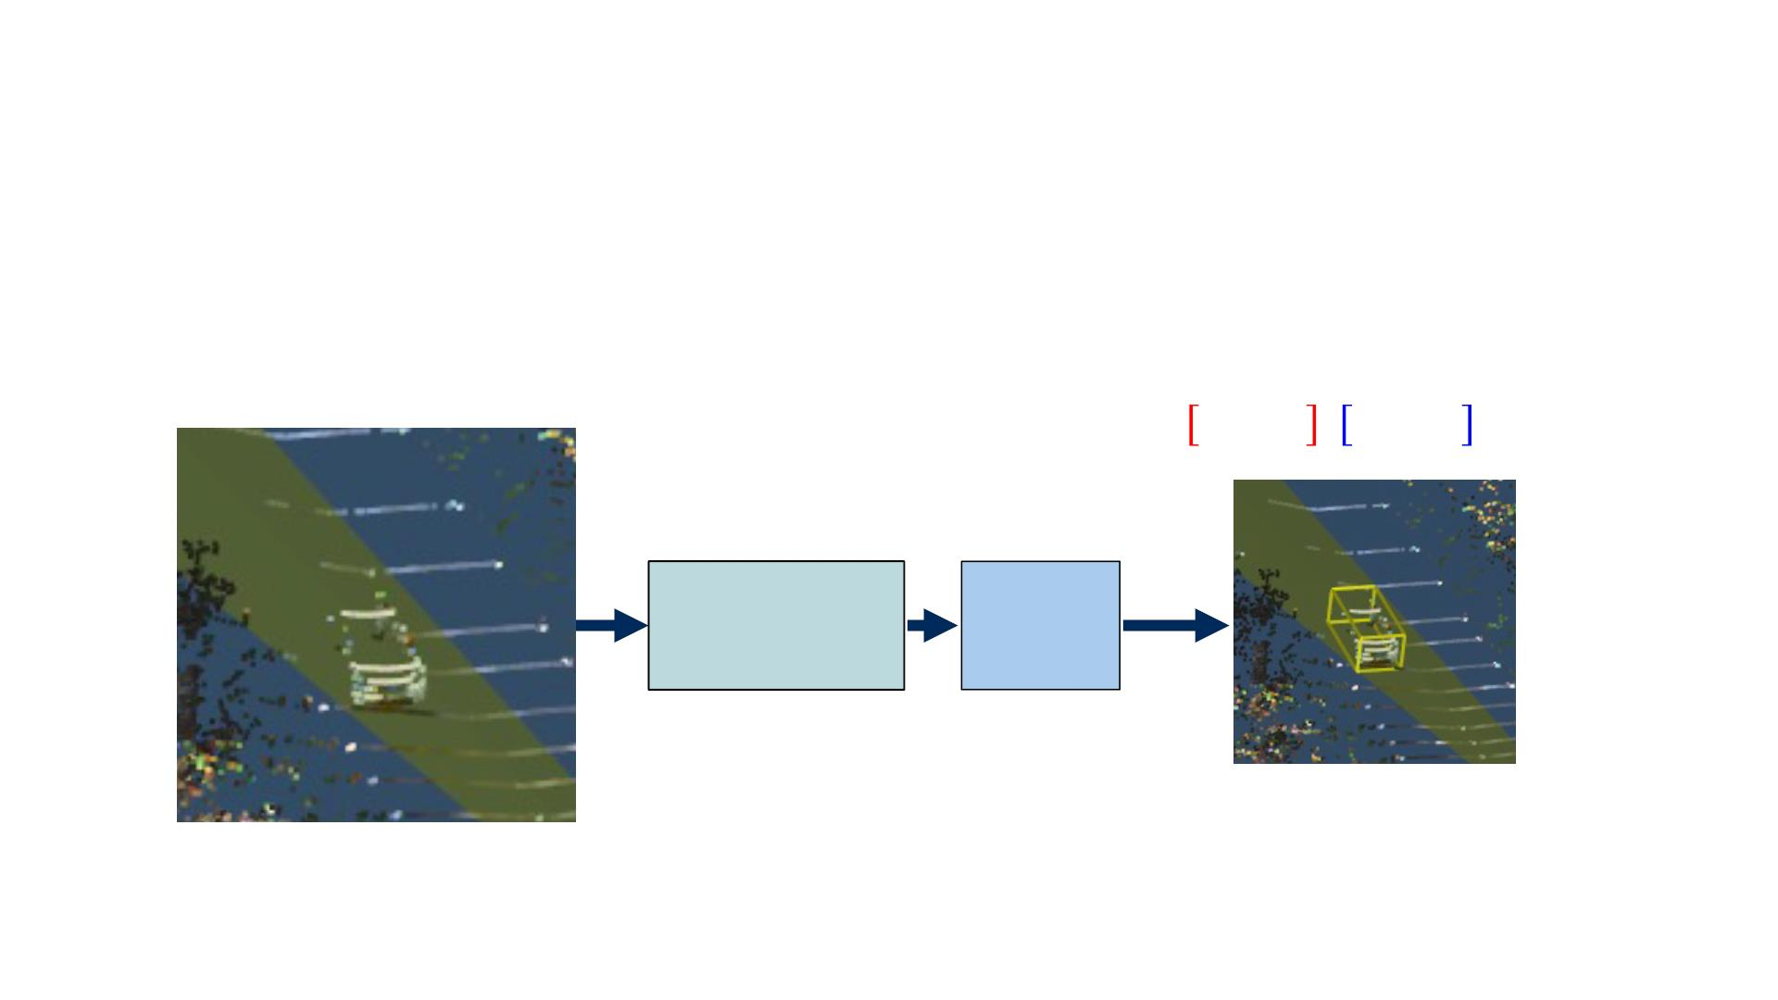
From 2D à 3D Object Detection
frustumのLiDAR pointsから3種類Representation:
Some groups choose to directly process the raw point cloud data. (X Y Z)
Others choose to normalize the point cloud data w.r.t. some fixed point such as the center of the frustum. (Normalized X Y Z)
One could also preprocess the points to build fixed length representations such as a histogram of x, y, z points, making their use as an input to a ConvNet much more convenient. (Histogram of X Y Z, まだ分かっていない)
!, #, $ , %, &, ℎ , (
Histogram of
X Y Z
Neural
Network

Slide 61
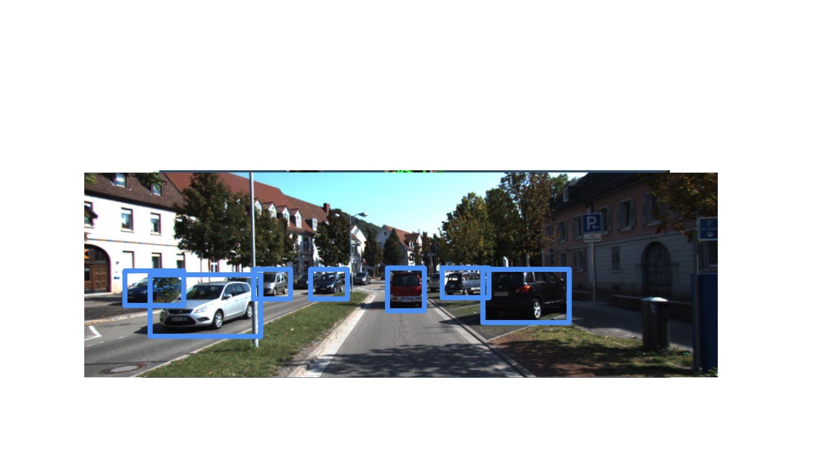
Typical 3D object detection results
Code at: https://github.com/kujason/avod

Slide 62
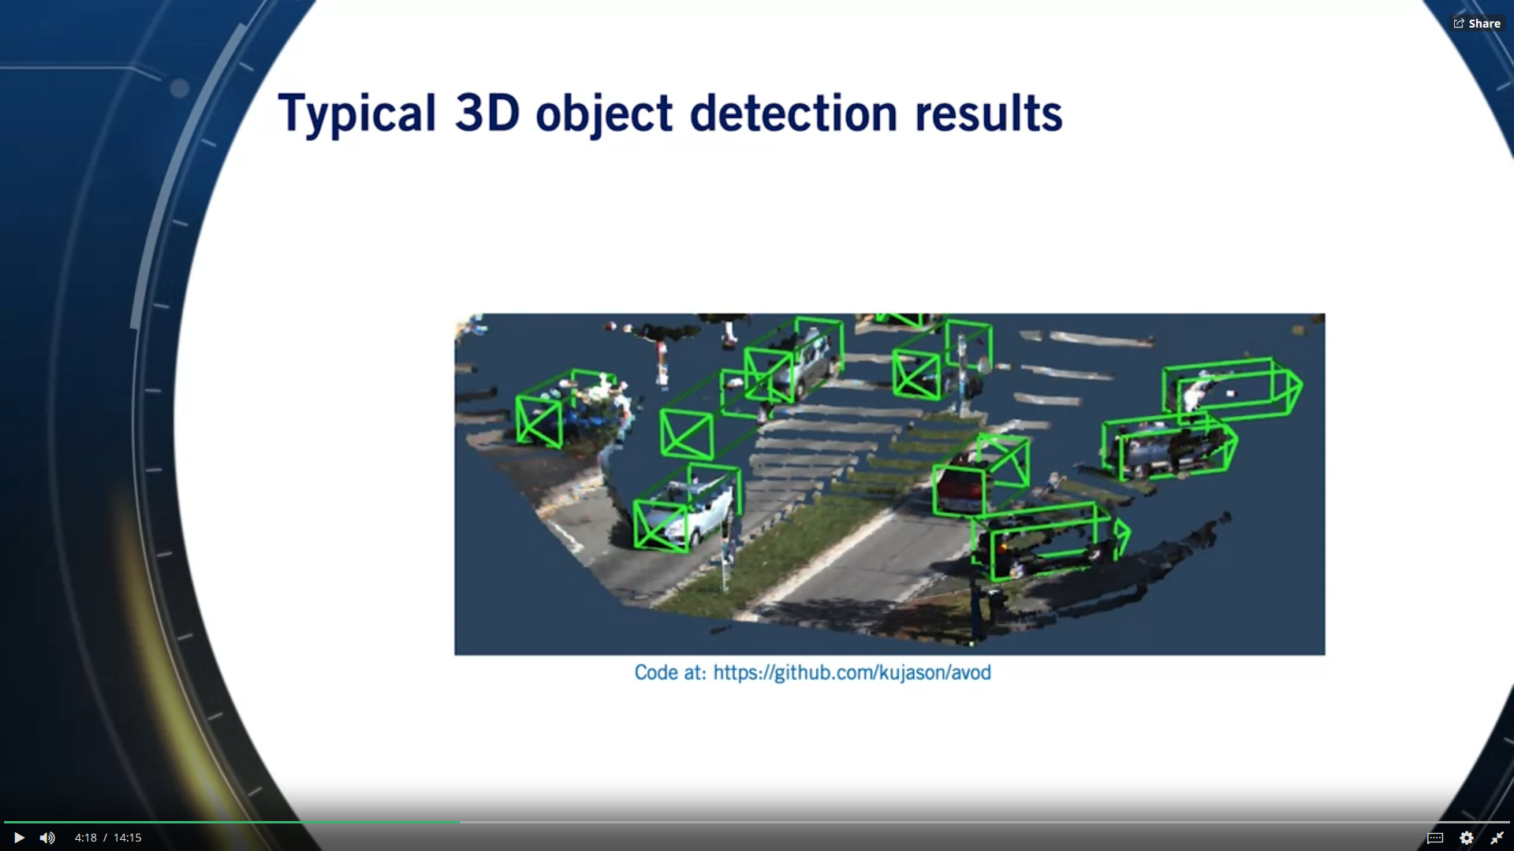
期待される結果：Oriented 3D bounding boxes

Slide 63
From 2D à 3D Object Detection
Searching a 3D space for possible objects is quite computationally expensive if no assumptions can be made about where the object should be found.
Extending 2D object detectors to 3D, usually allows us to limit the search region for object instances, keeping real-time performance manageable.
• Advantages:
o Allows exploitation of mature 2D object detectors, with high
precision and recall
o Class already determined from 2D detection
o Does not require prior scene knowledge, such as ground plane
location
• Disadvantages:
o The performance of the 3D estimator is bounded by the
performance of the 2D detector
o Occlusion and truncation（切り捨て） are hard to handle from 2D only
o 3D estimator needs to wait for 2D detector, inducing latency in
our system
Which may not affect the LiDAR data.
If this delay is significant, the system might not be safe enough to operate as vehicle reaction time is limited by perception latency.

Slide 64
2D Object Tracking
• Detection: We detect the object independently in
each frame and can record its position over time
• Tracking: We use image measurements to estimate
position of object, but also incorporate position
predicted by dynamics, i.e., our expectation of
object’s motion pattern
• Tracking Assumptions:
Constraining how quickly a scene changes.
For example, we assume that our camera and the tracked objects cannot teleport to different locations within a very short time.
o Camera is not moving instantly to new viewpoint
o Objects do not disappear and reappear in different places in
the scene
o If the camera is moving, there is a gradual change in pose
between camera and scene
All of these assumptions are logically valid in roads scenes.

Slide 65
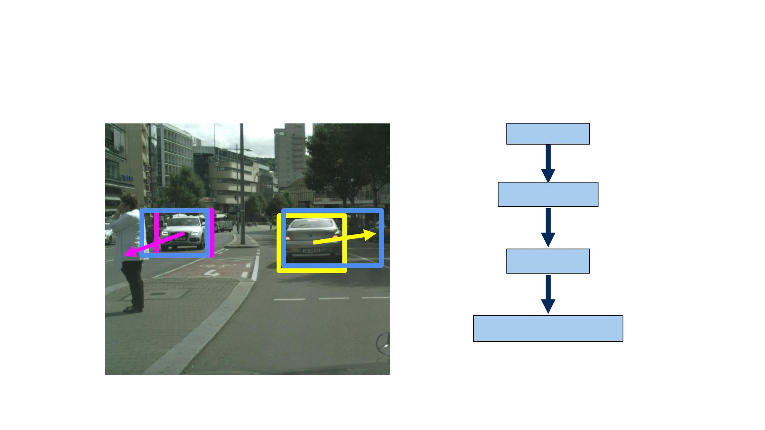
Given a detected object in the first frame along with their velocity vectors.
Prediction: We begin by predicting where the objects will end up in the second frame, if we model their motion using the velocity vector.
Measurement: We then get new detections in the second frame.
Correlation: We correlate each detection（predictionだと思う） with a corresponding measurement. 紐づけ
2D Object Tracking
Prediction
Measurement
Correlation
Measurement Update
Measurement Update: And then update our object detection using the correlated measurement.

Slide 66
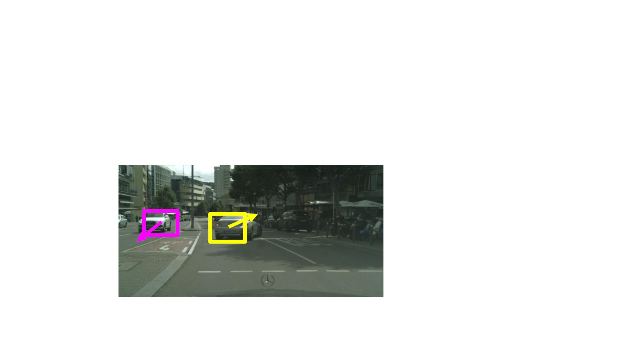
Object Tracking: Prediction
State: its position and velocity in image space.
• Each object will have a predefined motion model in
image space
That updates its state.
• Example: ! = ! + $ Δ& + '(0, Σ)
Constant velocity motion model.
!
!"#
!

Slide 67
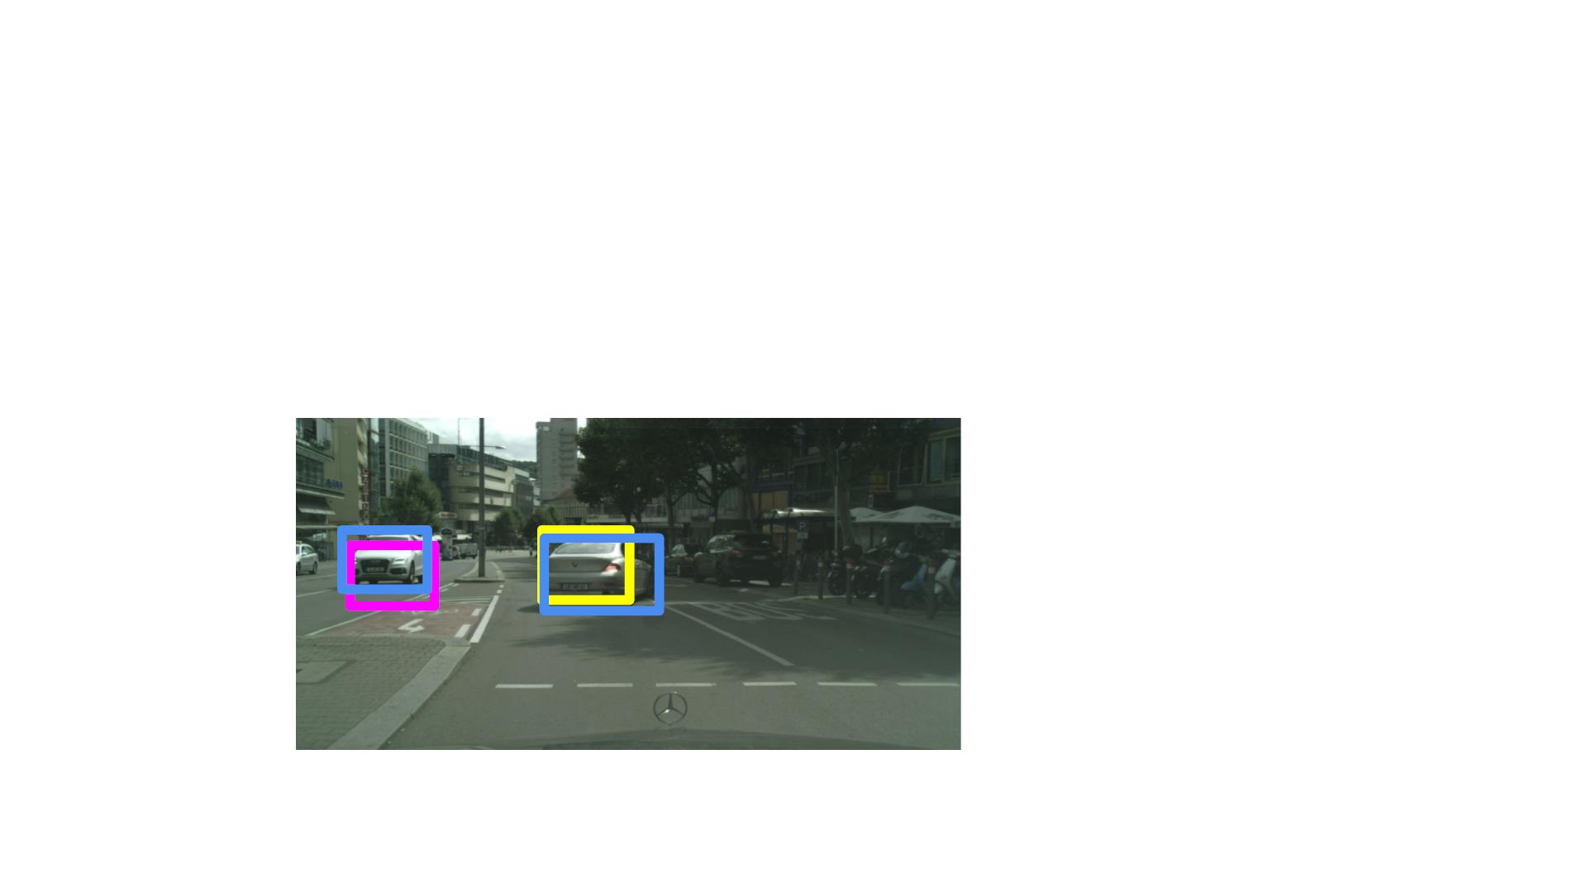
Object Tracking: Correlation
• Get Measurement Bounding Boxes from 2D
detector.
• Correlate prediction with the highest IOU
measurement
A measurement is correlated to a corresponding prediction if it has the highest IOU with that prediction.
predictionの相⼿measurementが存在しなければ、tracking終了。measurementの相 ⼿predictionが存在しなければ、tracking開始。

Slide 68
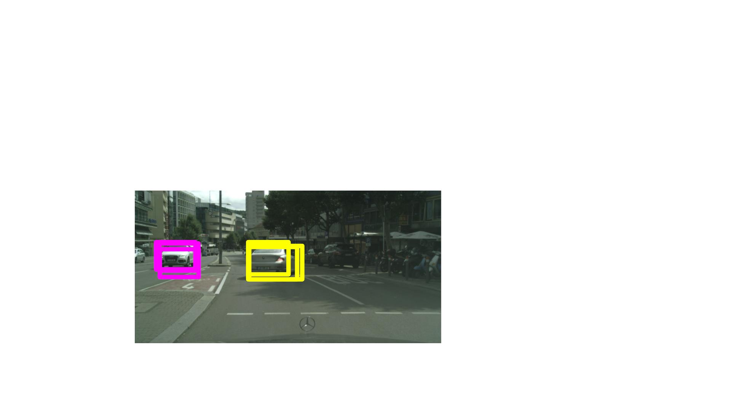
Object Tracking: Update
• The prediction and measurement are fused as part
of the Kalman Filter Framework
Note that we do not need to track the object sizes but can rely on the detector instead.

Slide 69
Object Tracking
課題：How to initiate tracks and how to terminate them.
• For each frame, we start new track if a measurement
has no correlated prediction
• We also terminate inconsistent tracks, if a predicted
object does not correlate with a measurement for a
preset number of frames
• The same methodology can be used to track objects
in 3D!
by defining IOU in 3D.

Slide 70

3D Object Tracking

Slide 71

Traffic Sign and Traffic Signal Detection
• Traffic signs and signals appear smaller in size
compared to cars, two-wheelers, and
pedestrians.
• Traffic signs are highly variable with many
classes to be trained on.
Usually including as many as 50 classes that need to be classified reliably.
• Traffic signals have different states that are
required to be detected.
• In addition, traffic signals change state as the
car drives!
Usually, traffic signs and traffic signals have to be detected at long range for a car to know how to react properly in a timely manner.
At long range, traffic signs and signals occupy a very small number of pixels in the image making the detection problem particularly challenging.

Slide 72

In this example, the first stage outputs class agnostic bounding boxes that point to all traffic signs and signals in the image.
The second stage then takes all of the bounding boxes from the first stage and classifies them into categories such as red, yellow or green signals, stop signs, etc.
Some methods also use the second stage to further refine the bounding boxes.
Traffic sign and signal detection
• 2D object detectors can be used to perform traffic sign and traffic signal detection without any modifications
• However, multi-stage hierarchical models have been shown to outperform the standard single stage object detectors
Image
Prior Boxes
Output Detections
Feature Extractor
Stage 1
Stage 2
The two stages share the output of the feature extractor to perform their respective task.

Slide 73
Summary
• The output of 2D object detectors can be extended
to produce 3D object location and dimensions
• The output of 2D object detectors in consecutive
frames can be used to track objects in 2D and in 3D
• The output of 2D object detectors can be used to
detect traffic signs and signals, and determine the
state of traffic signals
論⽂ - [2017] Frustum PointNets for 3D Object Detection from RGB-D Data: https://arxiv.org/abs/1711.08488

Slide 74

Faster R-CNNメモ：https://arxiv.org/pdf/1506.01497.pdf
In this work, we introduce a Region Proposal Network(RPN) that shares full-image convolutional features with the detection network, thus enabling nearly cost-free region proposals.
An RPN is a fully convolutional network that simultaneously predicts object bounds and objectness scores at each position.
Our observation is that the convolutional feature maps used by region-based detectors, like Fast R-CNN, can also be used for generating region proposals. On top of these convolutional features, we construct an RPN by adding a few additional convolutional layers that simultaneously regress region bounds and objectness scores at each location on a regular grid. The RPN is thus a kind of fully convolutional network (FCN) and can be trained end-to-end specifically for the task for generating detection proposals.
RPNs are designed to efficiently predict region proposals with a wide range of scales and aspect ratios.
Our scheme can be thought of as a pyramid of regression references (Figure 1, c), which avoids enumerating images or filters of multiple scales or aspect ratios.
To unify RPNs with Fast R-CNN object detection networks, we propose a training scheme that alternates between fine-tuning for the region proposal task and then fine-tuning for object detection, while keeping the proposals fixed. 講座には2番目のタスクのみ紹介されていたらしい。Anchorsは固定だった。
RPNs completely learn to propose regions from data, and thus can easily benefit from deeper and more expressive features (such as the 101-layerresidual nets adopted in [18]).

Slide 75



Faster R-CNNメモ：https://arxiv.org/pdf/1506.01497.pdf
Note that because the mini-network operates in a sliding-window fashion, the fully-connected layers are shared across all spatial locations.
3.1 Region Proposal Networks
3.1.1 Anchors
At each sliding-window location, we simultaneously predict multiple region proposals, where the number of maximum possible proposals for each location is denoted as $k$. So the $reg$ layer has $4k$ outputs encoding the coordinates of $k$ boxes, and the $cls$ layer outputs $2k$ scores that estimate probability of object or not object for each proposal. (For simplicity we implement the $cls$ layer as a two-class softmax layer. Alternatively, one may use logistic regression to produce $k$ scores.) The $k$ proposals are parameterized $relative$ to $k$ reference boxes, which we call anchors. An anchor is centered at the sliding window in question, and is associated with a scale and aspect ratio (Figure 3, left). By default we use 3 scales and 3 aspect ratios, yielding $k= 9$anchors at each sliding position.
If one translates an object in an image, the proposal should translate and the same function should be able to predict the proposal in either location. Sliding windowで同じanchorsを使っているから。
The design of multi-scale anchors is a key component for sharing features without extra cost for addressing scales.
上記の図から、proposalsはfeature mapsから作られたみたいが、講座にはproposalsは選ばれた（3:1のratioで選ばれたanchor boxes）。

Slide 76



Faster R-CNNメモ：https://arxiv.org/pdf/1506.01497.pdf
3.1.2 Loss Function
We assign a positive label to two kinds of anchors: (i) the anchor/anchors with the highest Intersection-over-Union (IoU) overlap with a ground-truth box, or (ii) an anchor that has an IoU overlap higher than 0.7 with any ground-truth box. （講座に2番目のみらしい。1番目の意味は、どのanchorとも70%以上重なっていないground truth boxが存在することだ。）
Usually the second condition is sufficient to determine the positive samples; but we still adopt the first condition for the reason that in some rare cases the second condition may find no positive sample.
3.1.3 Training RPNs
Each mini-batch arises from a single image that contains many positive and negative example anchors. あ！Mini-batchは一枚画像の話だ！
Instead, we randomly sample 256 anchors in an image to compute the loss function of a mini-batch, where the sampled positive and negative anchors have a ratio of up to1:1. If there are fewer than 128 positive samples in an image, we pad the mini-batch with negative ones. 講座には1:3だ。
3.2 Sharing Features for RPN and Fast R-CNN
In the first step, we train the RPN as described in Section 3.1.3. This network is initialized with an ImageNet-pre-trained model and fine-tuned end-to-end for the region proposal task. In the second step, we train a separate detection network by Fast R-CNN using the proposals generated by the step-1 RPN. 講座はRPNの部分だけ話したらしい。でもRPNだけでなぜ足りないの？左のLoss Functionからもう十分だと思う。
At this point the two networks do not share convolutional layers. In the third step, we use the detector network to initialize RPN training, but we fix the shared convolutional layers and only fine-tune the layers unique to RPN. 少しGANの学習と似てる気がする。
Finally, keeping the shared convolutional layers fixed, we fine-tune the unique layers of Fast R-CNN.
3.3 Implementation Details
For anchors, we use 3 scales with box areas of ${128}^{2}$, ${256}^{2}$, and ${512}^{2}$ pixels, and 3 aspect ratios of 1:1, 1:2, and 2:1.
Here,$i$ is the index of an anchor in a mini-batch and $p_{i}$ is the predicted probability of anchor $i$ being an object.
$t_{i}$ is a vector representing the 4 parameterized coordinates of the predicted bounding box, and $t_{i}^{∗}$is that of the ground-truth box associated with a positive anchor.
The two terms are normalized by $N_{cls}$ and $N_{reg}$ and weighted by a balancing parameter $λ$.
In our formulation, the features used for regression are of the same spatial size (3×3) on the feature maps. To account for varying sizes, a set of $k$ bounding-box regressors are learned. Each regressor is responsible for one scale and one aspect ratio, and the $k$ regressors do not share weights. As such, it is still possible to predict boxes of various sizes even though the features are of a fixed size/scale, thanks to the design of anchors. （僕の予想と同じく、k anchorsは同じfeaturesを利用して、回帰している。）

Slide 77
Faster R-CNNメモ：https://arxiv.org/pdf/1506.01497.pdf
We note that our algorithm allows predictions that are larger than the underlying receptive field.
During training, we ignore all cross-boundary anchors so they do not contribute to the loss. For a typical 1000×600 image, there will be roughly 20000 (≈60×40×9) anchors in total. With the cross-boundary anchors ignored, there are about 6000 anchors per image for training. If the boundary-crossing outliers are not ignored in training, they introduce large, difficult to correct error terms in the objective, and training does not converge.
One-Stage Detection vs. Two-Stage Proposal + Detection
The OverFeat paper proposes a detection method that uses regressors and classifiers on sliding windows over convolutional feature maps. OverFeat is a one-stage, class-specific detection pipeline, and ours is a two-stage cascade consisting of class-agnostic proposals and class-specific detections. Loss Functionから見ると、class-agnosticではないらしいけど。
Though both methods use sliding windows, the region proposal task is only the first stage of Faster R-CNN—the downstream Fast R-CNN detector attends to the proposals to refine them. In the second stage of our cascade, the region-wise features are adaptively pooled from proposal boxes that more faithfully cover the features of the regions. 分かった！なぜRPNだけじゃ足りない！RPNを学習する時、固定sliding windowの特徴を使っていたんだ。RPNの学習が完了したら、proposal boxが勧められて、そのproposal box内の特徴を使って検知するんだ！RPNだけでもclass scoreは出るが、そのclass scoreを出すために使った特徴は固定の3x3 windowの特徴だ！もっと正しく出すために、RPNがくれたproposal box内の特徴を使うべきだ！

